Slide 1
How to use Jobscan and TagCrowd to match your LinkedIn profile and résumé with a job description

Slide 2
How to increase your chances of being selected by recruiters
Ensure that you are a match with the job description
Use Jobscan to match your résumé to the job description

Slide 3
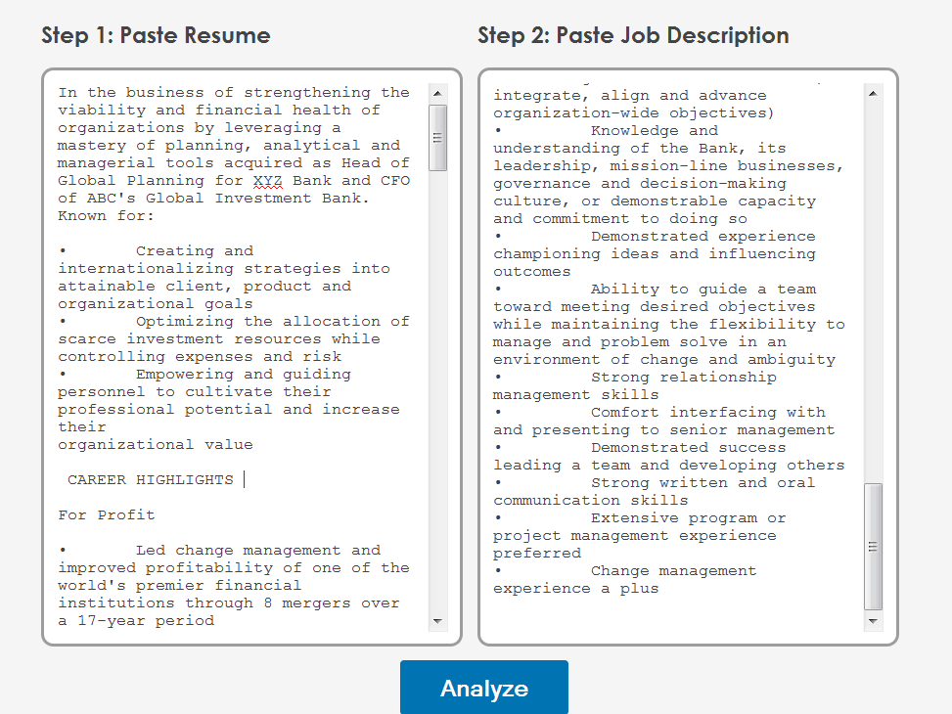
Jobscan compares the résumé with the job description

Slide 4
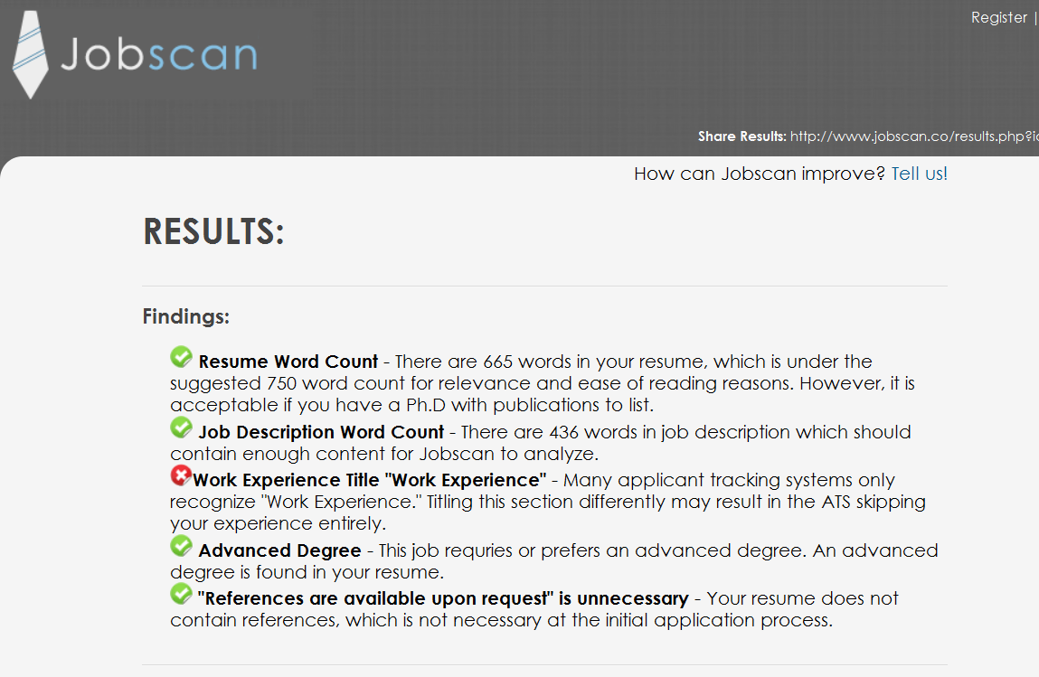
Jobscan displays the findings

Slide 5
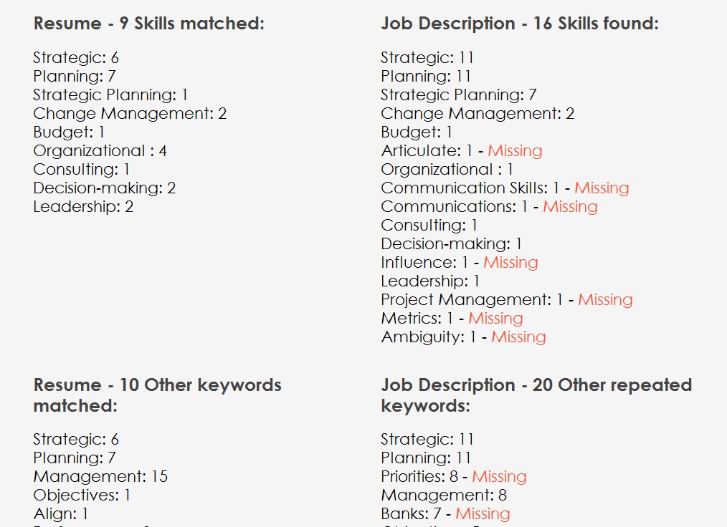
Jobscan compares the résumé with the job description

Slide 6
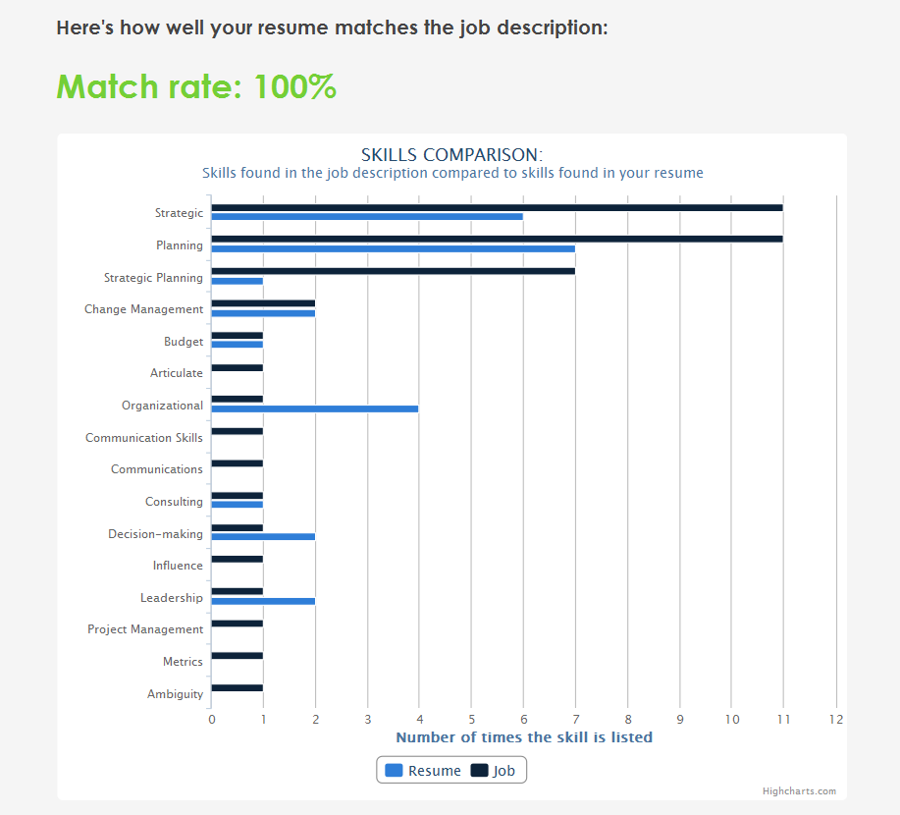
Visual match by keywords

Slide 7
Now use a different software: TagCrowd
Use TagCrowd to make sure your résumé contains most of the keywords that recruiters are likely to use as queries based on the job description

Slide 8
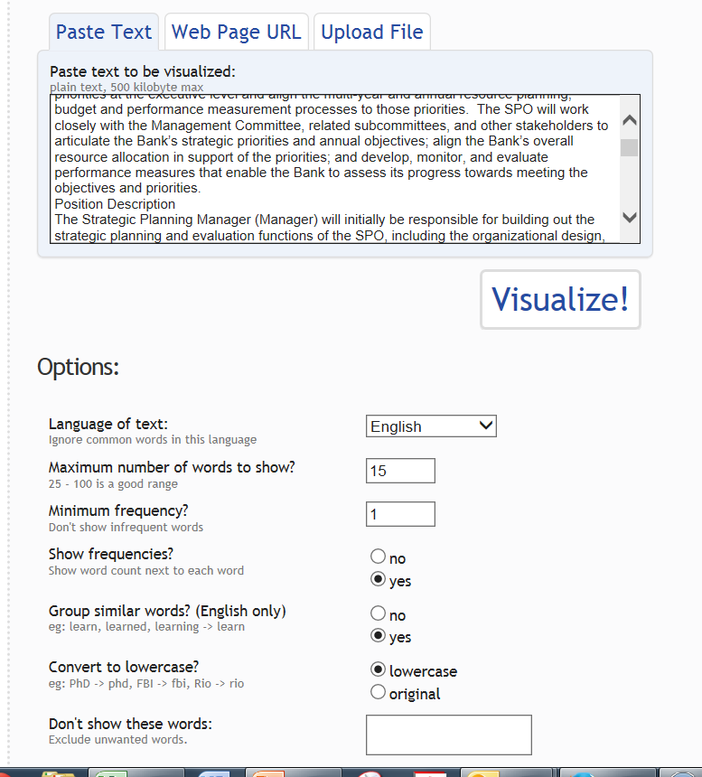
Paste the job description and click Visualize!

Slide 9
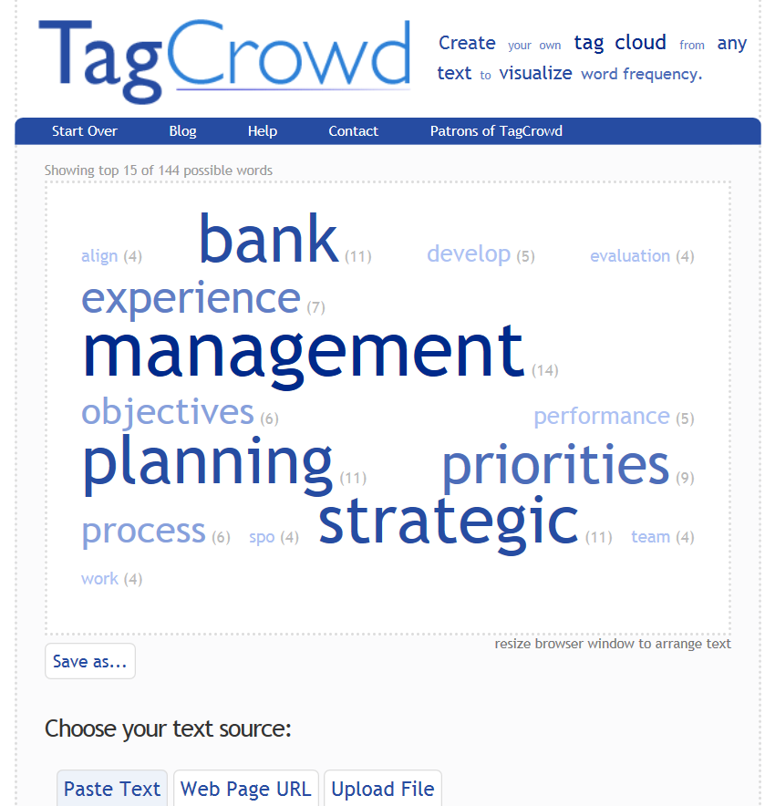
This is how the job description is displayed

Slide 10
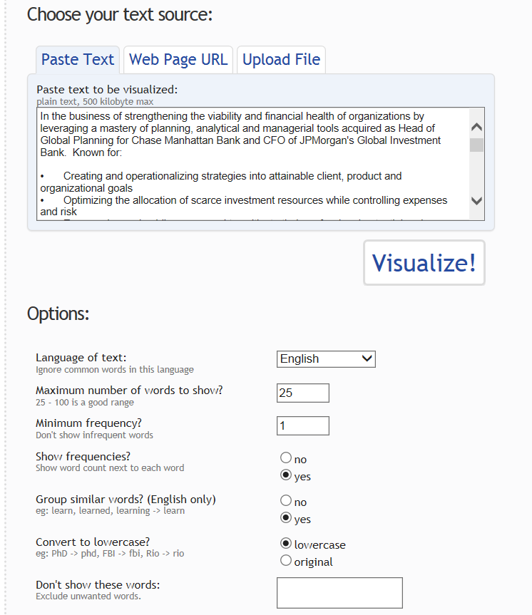
Now paste the résumé

Slide 11
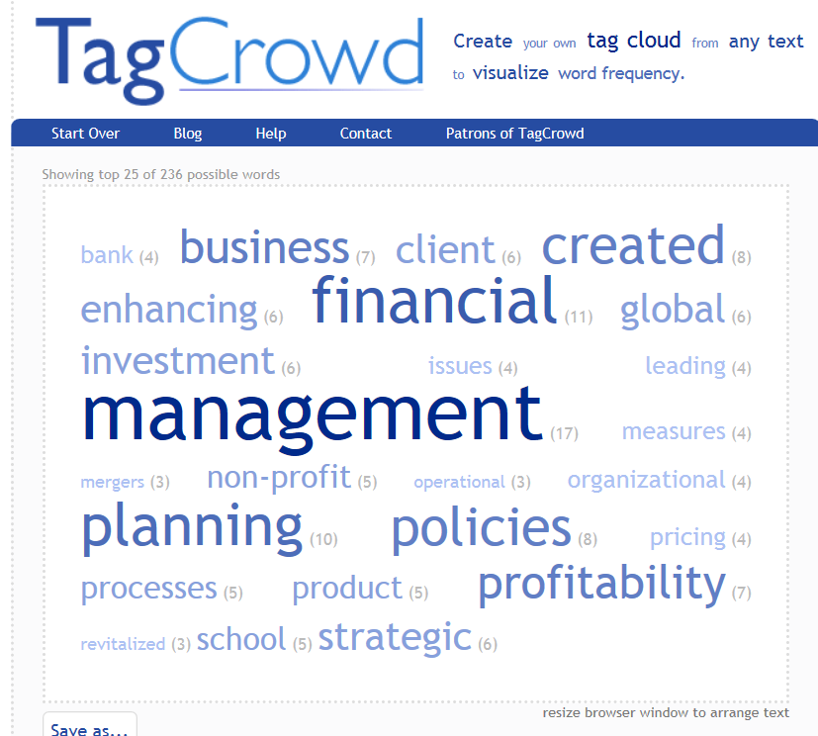
Display of the résumé

Slide 12
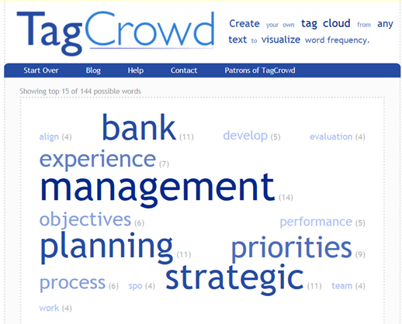
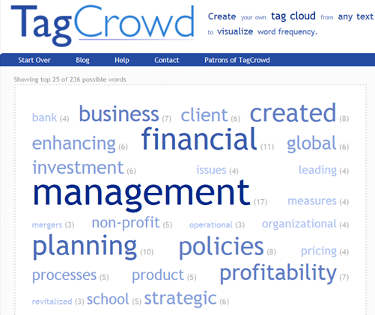
Compare the job description and the résumé

Slide 13
.
Questions?
If you have questions you’d like to ask me do not hesitate to contact me.
Alex Freund
609-333-8866
alex@landingexpert.com
www.landingexpert.com
Notes:
13

