Slide 1
Preparing for the Job Hunt: The Essential Checklist
Valerie S. Williams
April 8, 2017

Slide 2
Notes:
The slides and templates will be provided
Ask questions

Slide 3
First Reaction

Slide 4
Finances
Review
Monthly expenses including activities
Ways to reduce expenses
Immediate and semi-immediate availability of savings
401k/IRA and any penalties
Consult Your Financial Advisor/Accountant

Slide 5
Your State of Mind
Acknowledge your feelings.
Who/what is your support system?
How do you regroup?
How do you keep positive?
What keeps you going?
What drives you?
What makes you laugh?
LEAVE THE HOUSE!

Slide 6
Regroup and Rethink
What do you like to do?
What do you NOT like to do?
What did you like about your previous jobs?
What did you NOT like about your previous jobs?

Slide 7
Self Assessment & Tests
Identify cross functional skills
Rank your skills
Ask for feedback from others
https://www.monster.com/career-advice/article/best-free-career-assessment-tools
Myers-Briggs
http://tests.marketpsych.com/test_question.php?id=13
http://www.funeducation.com/Tests/PersonalityTest/TakeTest.aspx

Slide 8
Consider All Options
Full, part time or contract position
Own your own business
Non-profit organizations
Small vs. large companies
Alternative industries

Slide 9
Get A Calendar
Family events
Volunteering
https://www.volunteermatch.org/
http://createthegood.org/
Networking opportunities
Organizational/industry meetings
Interviews
Notes:
Get a calendar to track your activities.

Slide 10
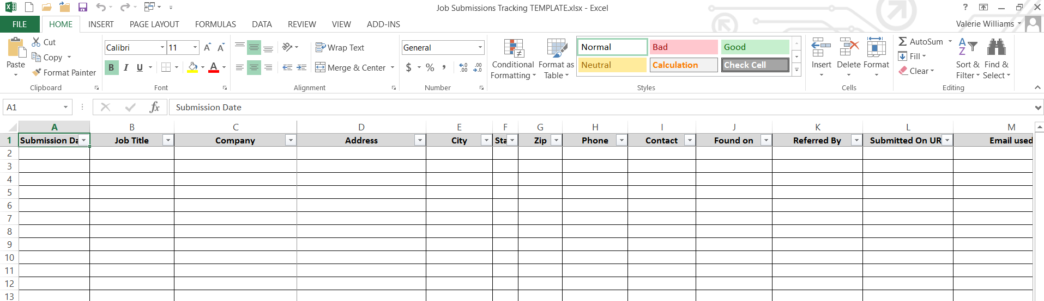
Tracking Spreadsheet - Job Submissions
Submission date
Job title
Company name
Address
Phone
Contact
Found on
Submitted on URL
Email used
Reference
Notes
Status

Slide 11
Tracking Spreadsheet – Additional Information
Recruiters
Contact name
Company
Address
Email address
Work number
Cell number
Notes
Training
Training Company
Address
Phone
Contact
Class name
Hours/CEUs/PDUs
Number of days
Cost
Start-End dates
Salary Info
Hourly
Daily
Weekly
Monthly
Yearly
Travel
Date
Event
Organization
Location
Mileage (1 way/round trip)
Tolls (1 way /round trip)
Parking

Slide 12
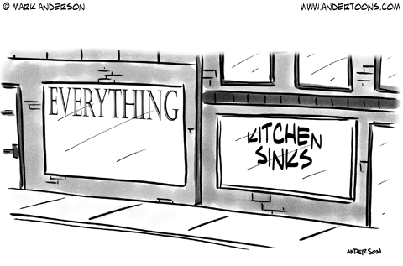
Master Resume
Summary
EVERY job you’ve ever had
EVERYTHING you ever did
Certifications and/or licenses
Education
Technical Skills
Publications and/or presentations
Volunteer groups
Notes:
Gary Lande – master resume

Slide 13
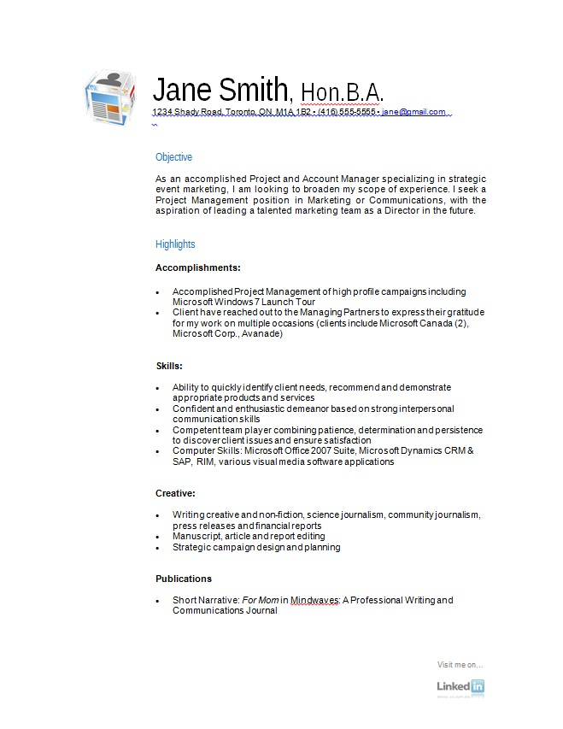
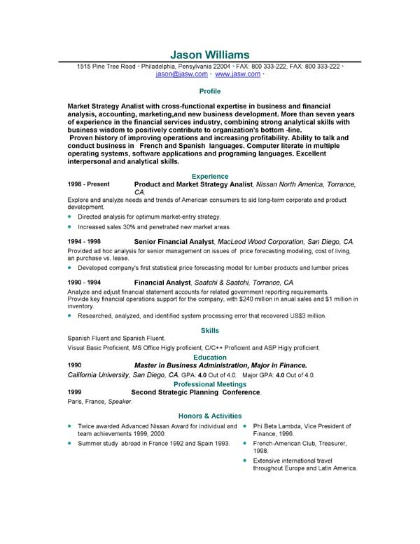
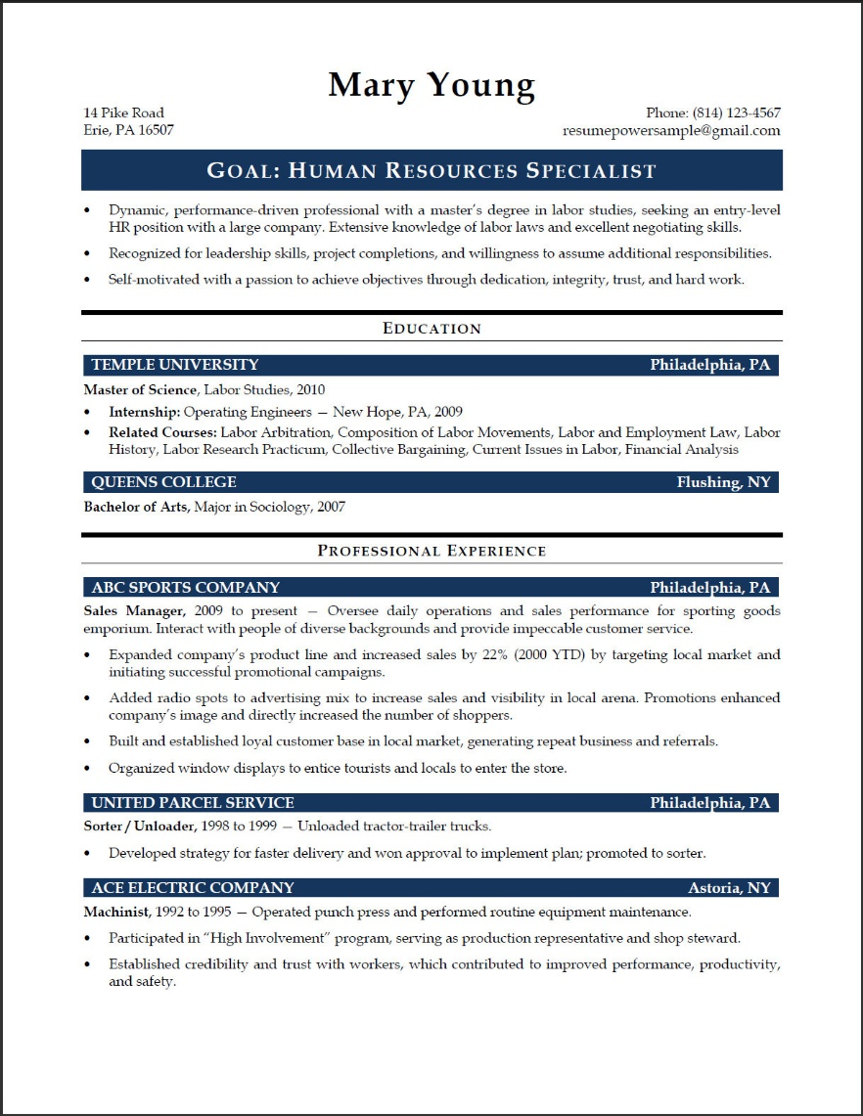
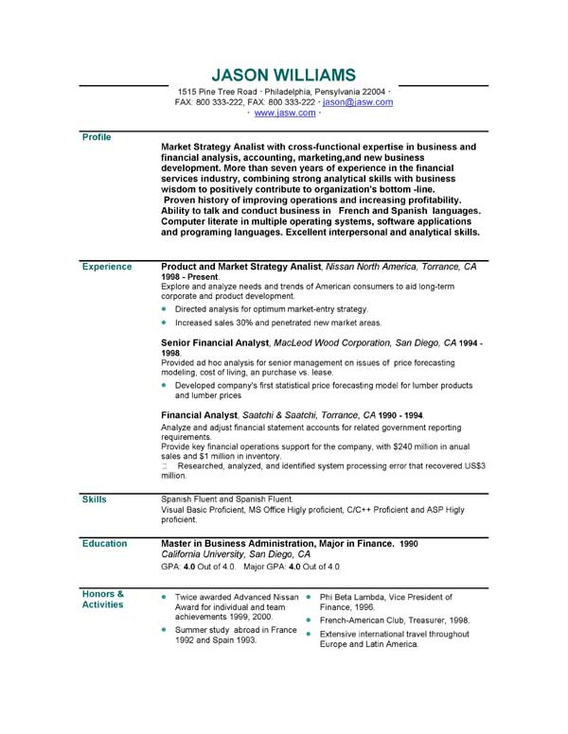
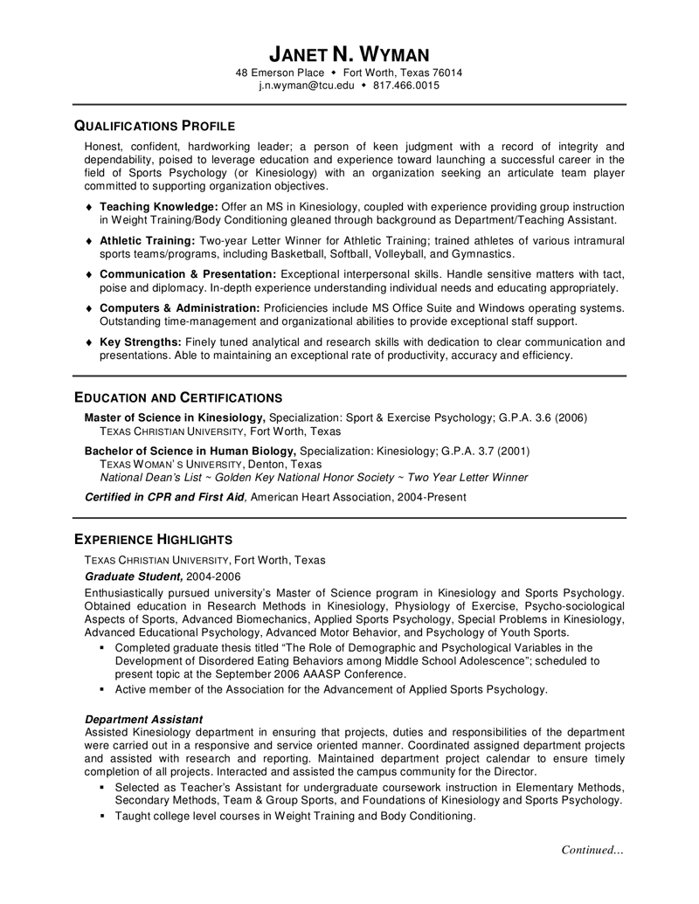
Resume Formatting
Notes:
Gary Lande – master resume

Slide 14
Additional Documents
Professional Objective
Cover letter
T-letter
A thank you letter
Copy of relevant presentations/publications
Answers for standard interview questions
List of questions for the interviewers

Slide 15
Addition Information
Personal info, i.e.
Address
Phone number
Email address
LinkedIn account
Certification ID#
Previous company info
Address, phone
Previous/last manager’s name
Previous salary
College info
Degrees
Mailing address
Transcripts
Salary
Ranges
Requirements
Health care
401k
PTO

Slide 16
Email Branding
Use gmail, yahoo or a branded provider
Names should be professional, i.e. johndoe@gmail.com
Personal website
Use AOL and/or prodigy
Non-professional names, i.e. Princess@aol.com, Jane1965@gmail.com
Comcast and Verizon information could be lost if you switch carriers

Slide 17
Business Card Branding
Business cards
Name
Title/Job
Phone number
Email
LinkedIn
Tag line
List of skills for the back
Badge/lanyard
http://www.vistaprint.com
http://www.staples.com/
https://www.moo.com/us/

Slide 18
Profile Pictures
https://www.photofeeler.com/

Slide 19
The Elevator Speech a.k.a. The Introduction
Smile
Speak up & measured
Create multiple lengths, i.e. 5, 10, 15, 30 seconds or 1, 5, 10 minutes
Name triggers
What you can do for the company
How you can add value to the company
Frown
Mumble or speed talk
Avoid long speeches
How long you’ve been with a company
How wonderful you are
Notes:
Alex Freund

Slide 20
Create Sample Presentations/Documents
Microsoft Project plan
Microsoft Power Point presentation
Microsoft Excel spreadsheet/chart
Marketing plan

Slide 21
Social Media Wheel
https://en.wikipedia.org/wiki/Social_media

Slide 22
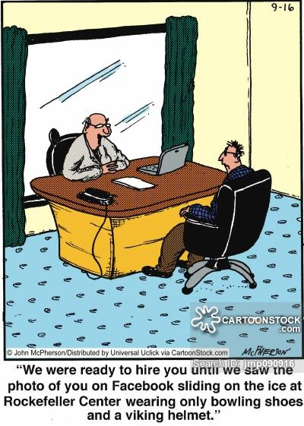
Social Media Accounts
LinkedIn
Twitter
Instagram
Facebook
Meetup.com
YouTube
Pinterest
Google+
Flickr
SlideShare

Slide 23
Training/Personal Development
Library card
Mercer County, https://www.mcl.org/
eLibraryNJ.com
HooplaDigital.com
One Stop with Unemployment
Ready to Work NJ (6 months or more), i.e. https://rtwnj.org/
YouTube
Lynda.com
Microsoft.com

Slide 24
The Interview Prep
Printed copies of resume and t-letter
Learn about the company and interviewer
Questions you want to ask
What you do/do not want to do
Several outfits
Test drive the route

Slide 25
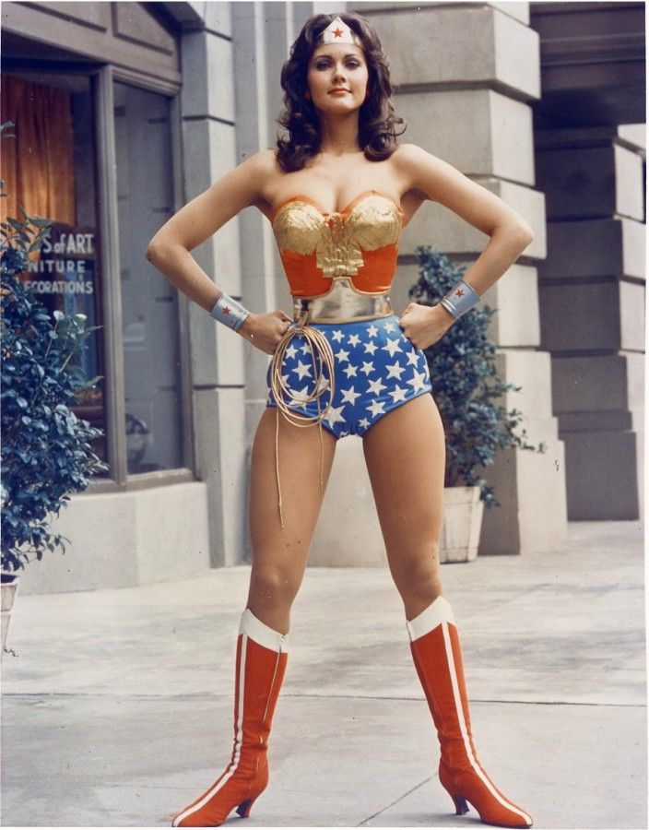
The Interview
Turn off your phone
Power pose, deep breaths
Amy Cuddy: Power Pose
Know you’re prepared
BE YOURSELF!

Slide 26
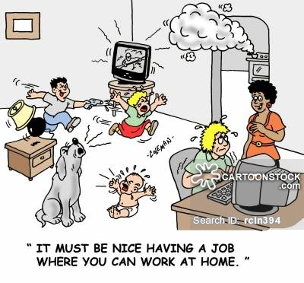
Video Conference Calls/Interviews
Skype / Zoom
YouTube: How to Look Good in Skype Interviews

Slide 27
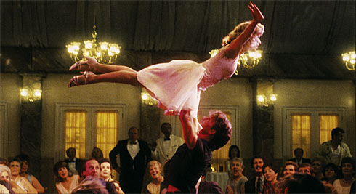
Stress Reducer/Hobby(ies)

Slide 28
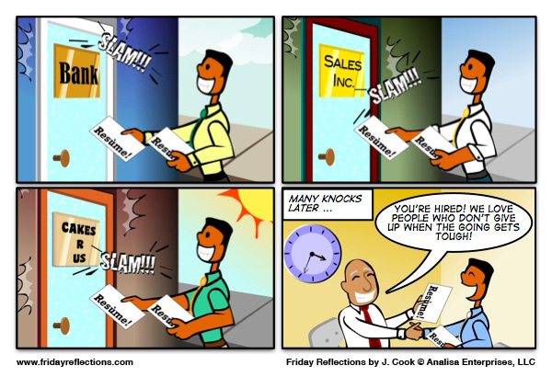

Slide 30
Contact Info
Valerie S. Williams
vswilliams7143@gmail.com
https://www.linkedin.com/in/williamsvaleries

