Slide 1
How are Trustworthy Others Telling Your Story to Hiring-Process Influencers? Andy O’Hearn February 10, 2018

Slide 2
Copyright and Disclaimer
COPYRIGHT © 2018 ANDREW M. O’HEARN ‒ ALL RIGHTS RESERVED
All rights reserved. No part of this presentation may be reproduced in any form or by electronic, photographic or mechanical means ‒ except in the case of brief quotations embodied in articles or reviews – without express permission from Andrew M. O’Hearn.
This presentation, including examples, is provided for informational purposes only; the author makes no warranties, either express or implied.
Without limiting the rights under copyright, no part of this presentation may be reproduced, stored in, or introduced into a retrieval system, or transmitted in any form or by any means (camera, video camera, web camera, flash drive, electronic, mechanical, photocopying, recording, or otherwise), or for any purpose, without the express written permission of Andrew M. O’Hearn.
The names of actual companies and products mentioned herein may be the trademarks of their respective owners.

Slide 3
Personal Brand
Visual Impact
Referrals
“Beauty Contest”
The Great 28
10 Bees
LI Guru Tour
Headline = Life ”
Bite Size (Chunx)
“Post-all” Service
Verb>Noun>Adj.
Ikigai
F2F/Relationships

Slide 4
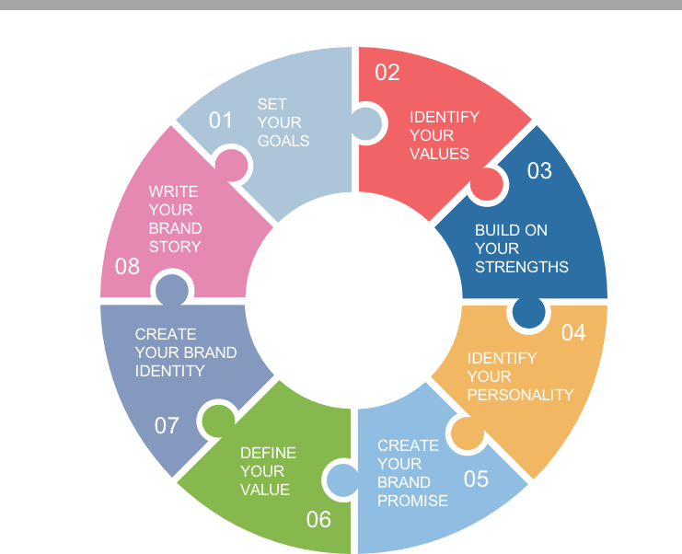
PERSONAL BRAND

Slide 5
all
pix

Slide 6
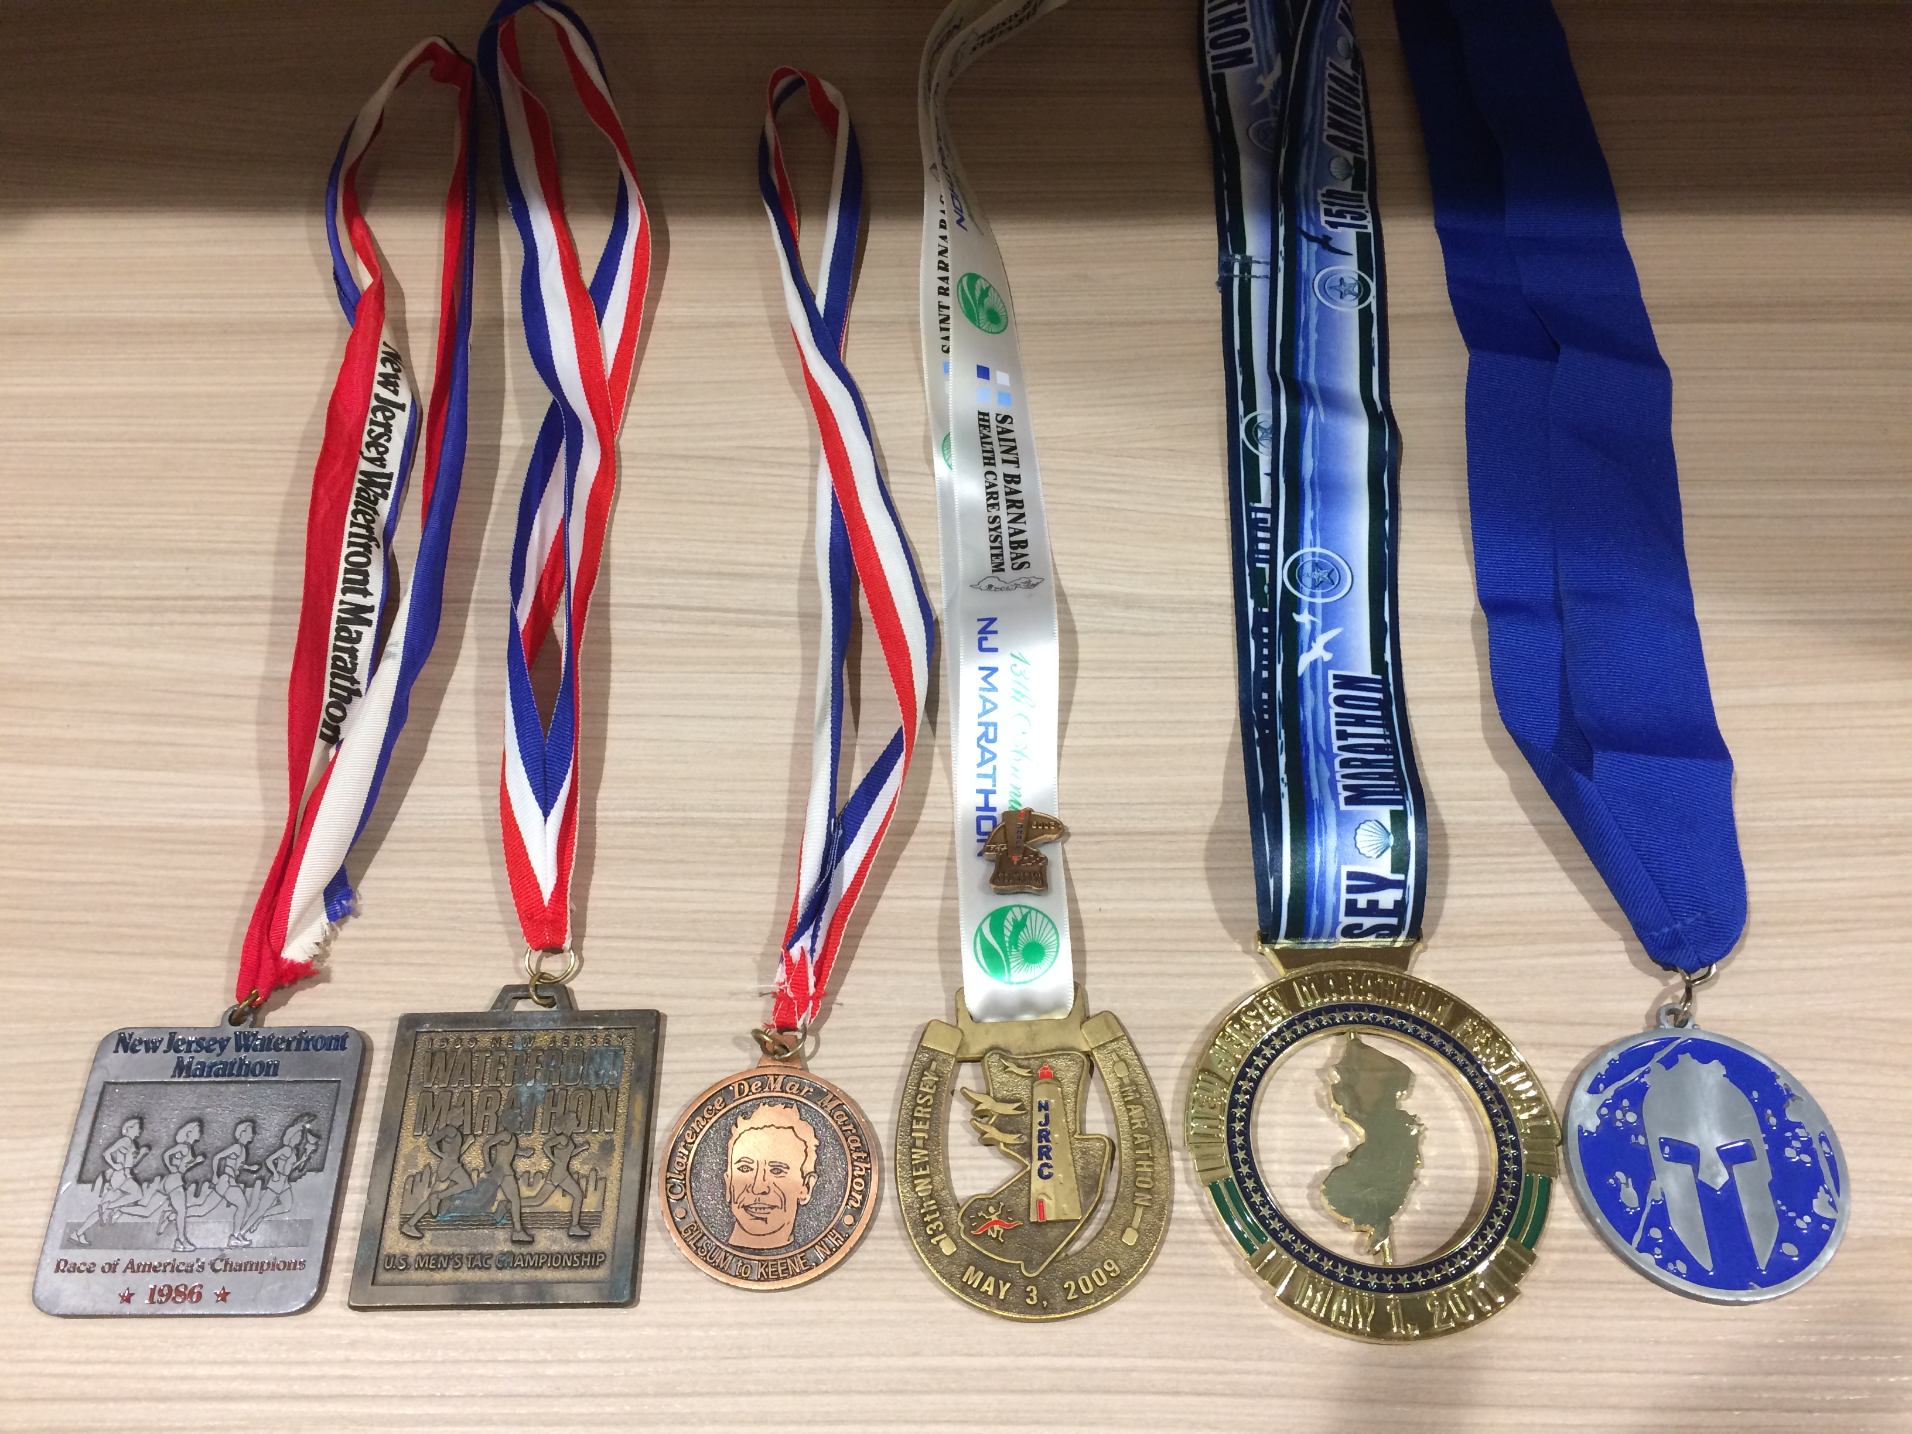
Notes:
8+ MILES / 25+ OBSTACLES: The Spartan Super obstacle race provides an 8+ mile/20+ obstacle riddled battlefield of insane terrain, combined with obstacles to test your physical strength and mental resolve. The Spartan Super is designed to push you to your limits, show you the strength inside, and lead you across the finish line.

Slide 7
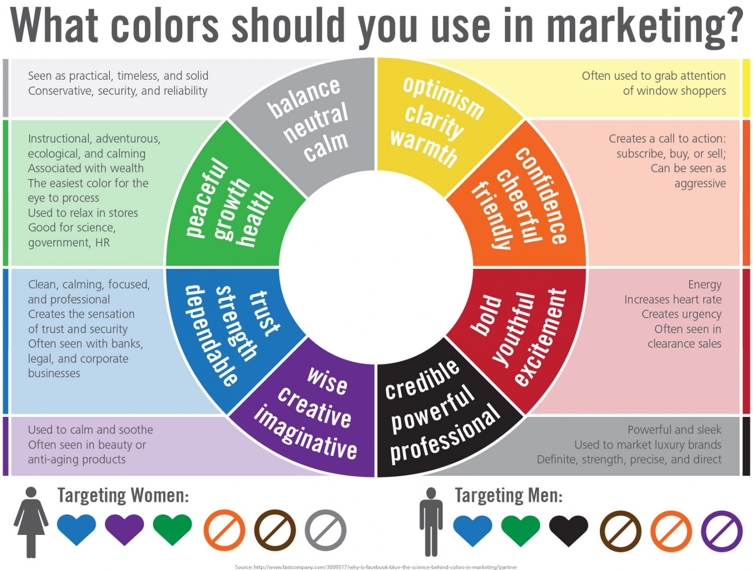
VISUAL IMPACT

Slide 8
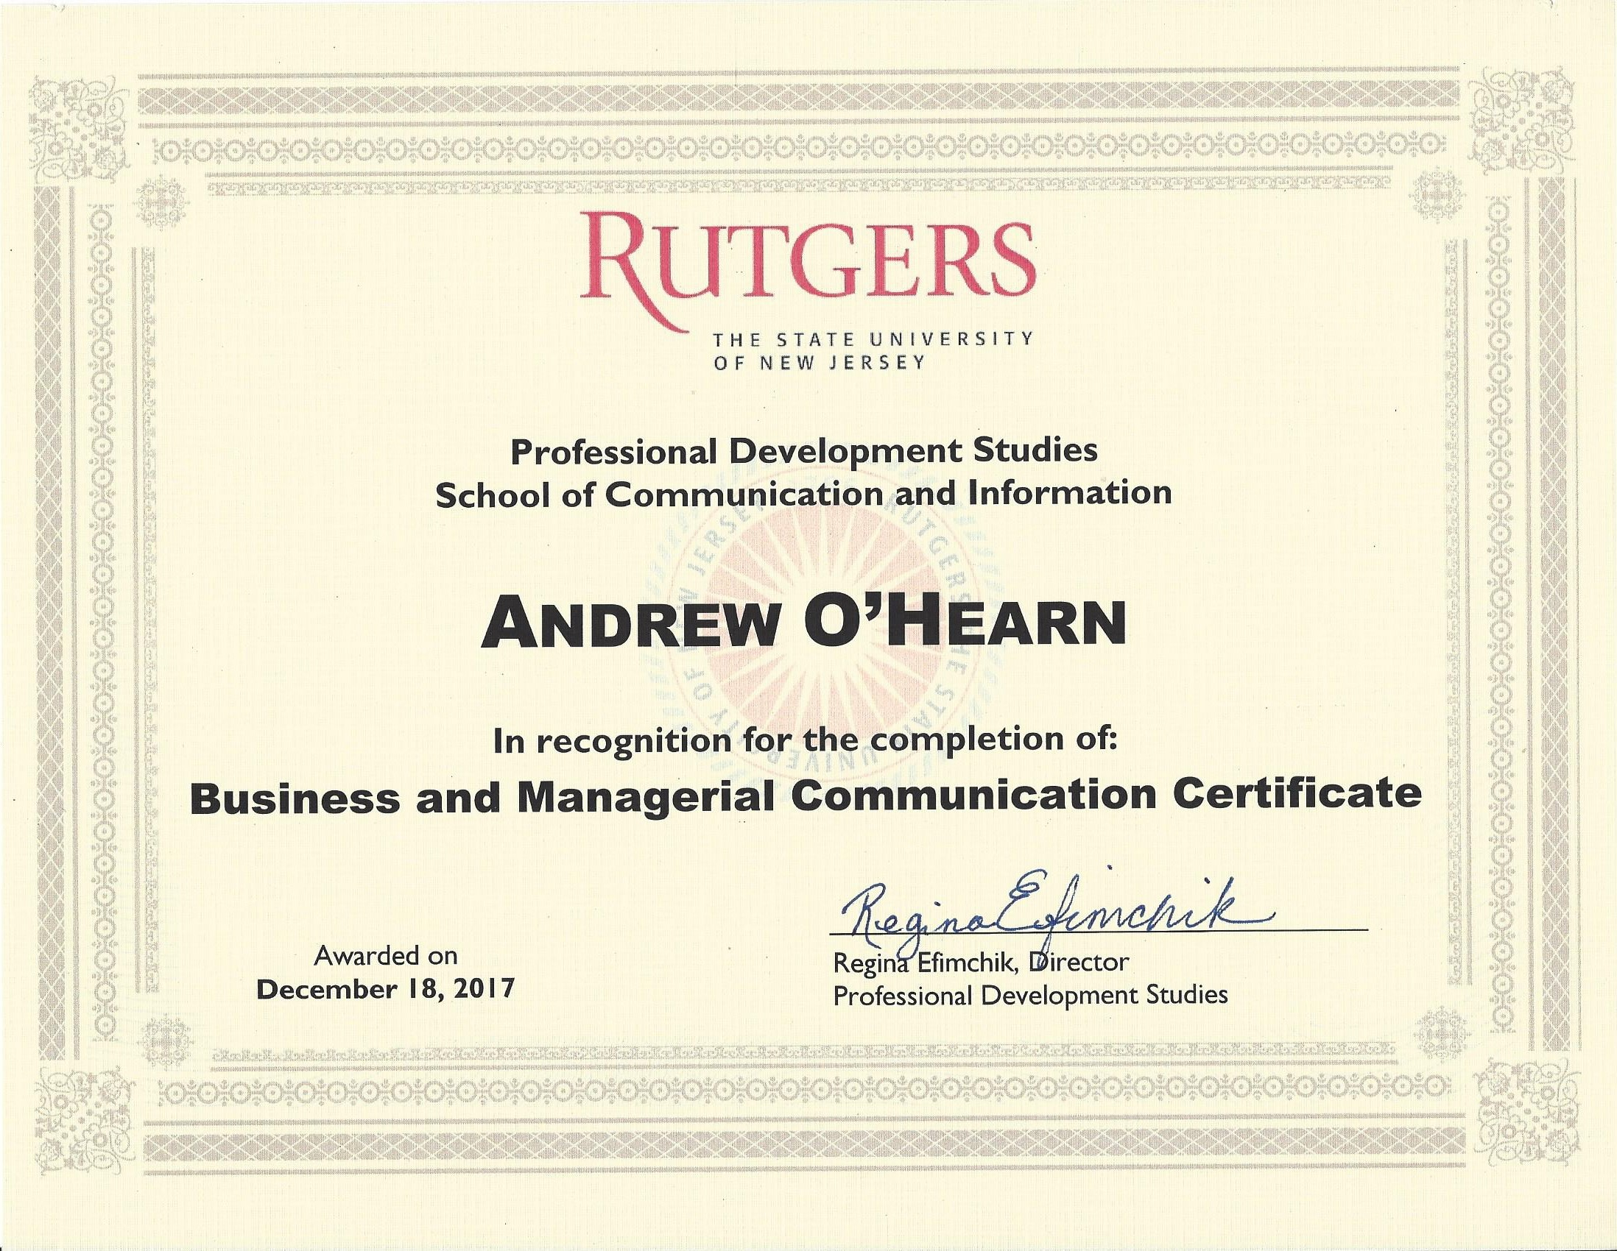

Slide 9
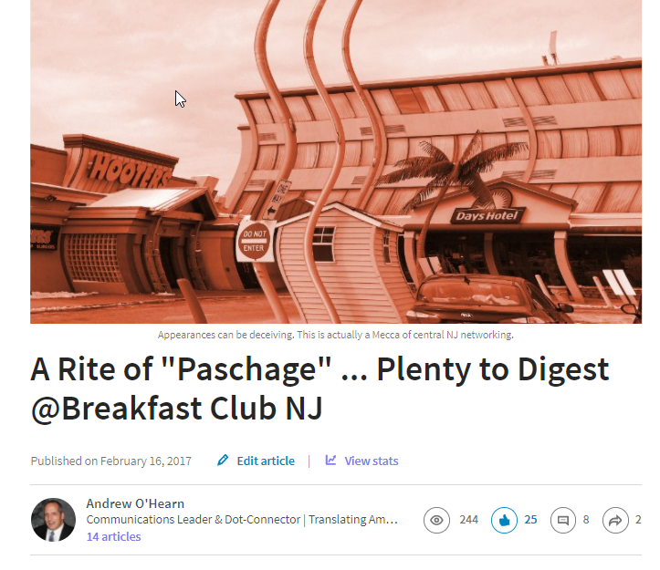

Slide 10
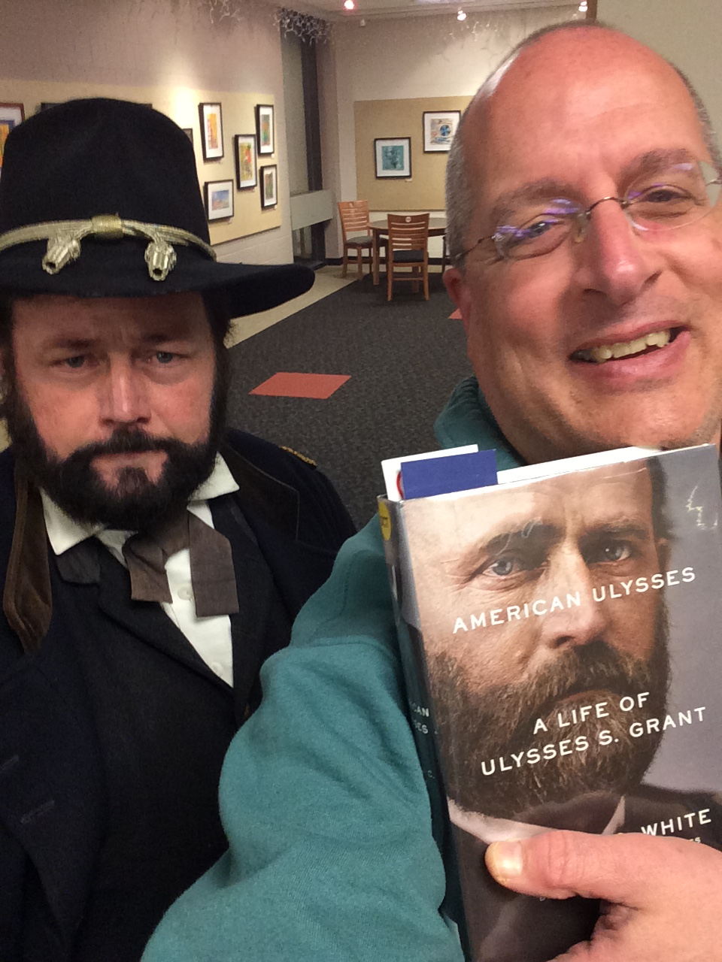
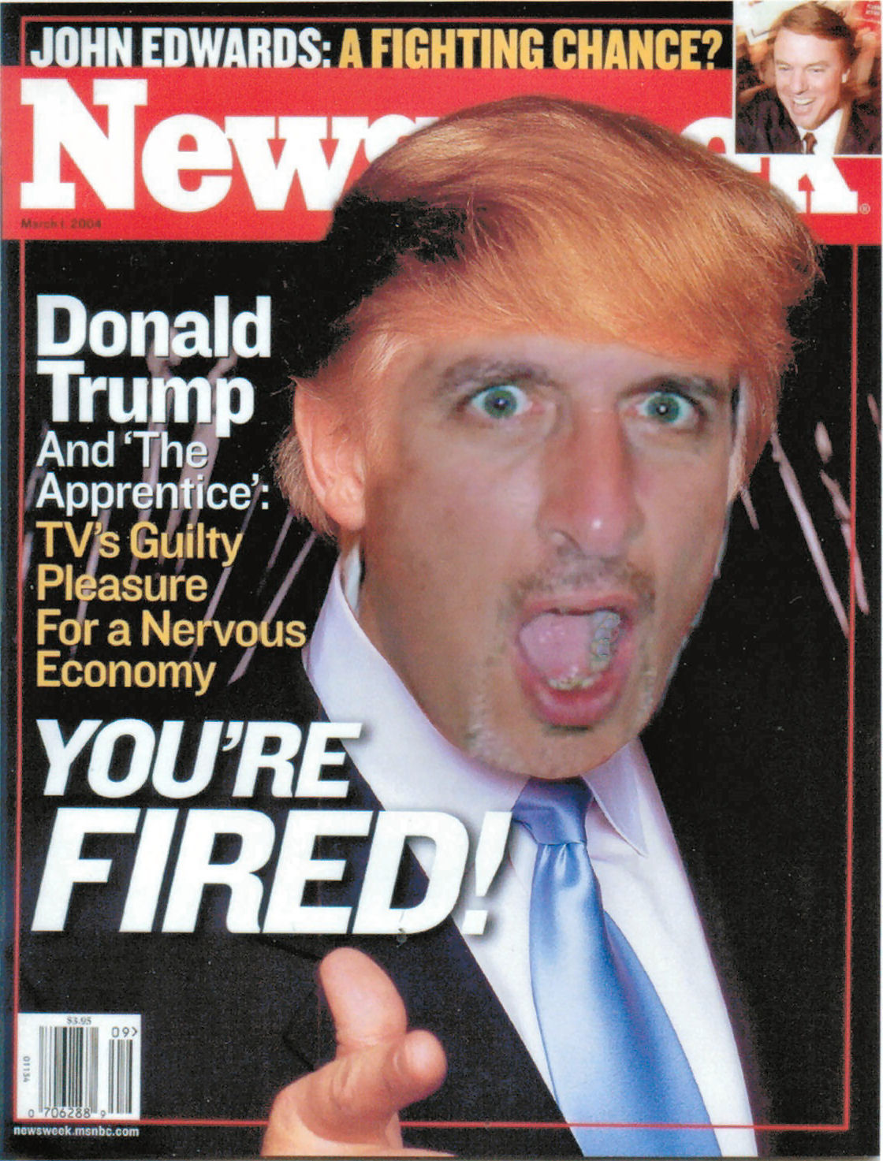

Slide 11
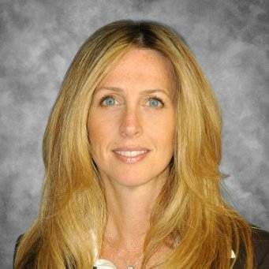
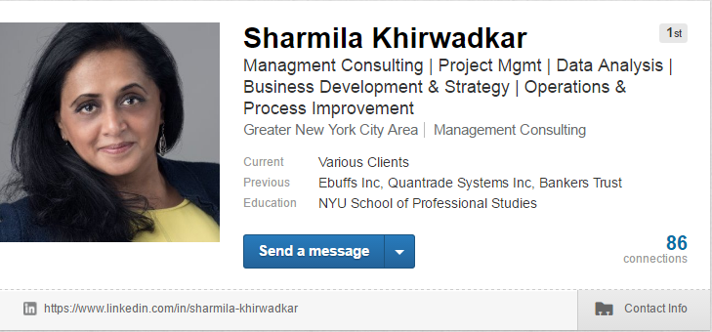
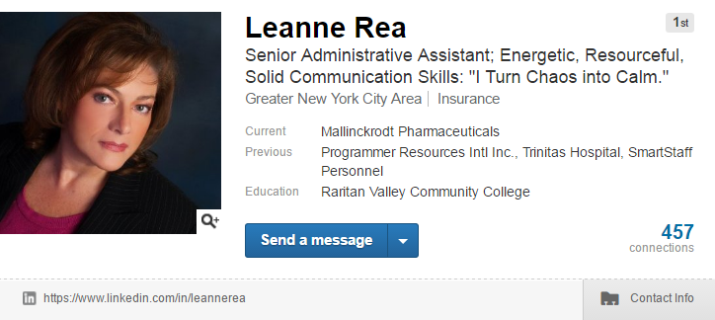
Display the Best Visuals You Can
←
Photographer: Monica Khanna 609.240.6709 www.instagram.com/princetonheadshots www.princetonheadshots.com
American Society of Media Photographers: http://findaphotographer.org
Professional Photographers of America: www.ppa.com/findaphotographer
Photographers Index: www.photographersindex.com
Photoshelter: www.photoshelter.com/explore/photographers
NOWA Photographers: http://www.nowa.org/directory/photographers.htm
Source: Donna Serdula; http://www.linkedin-makeover.com/

Slide 12
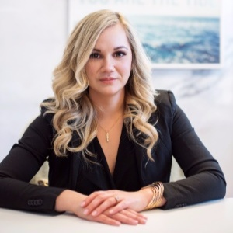
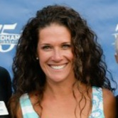
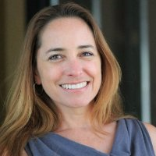
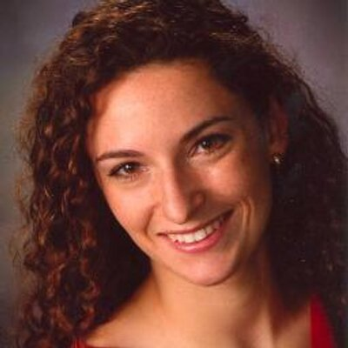
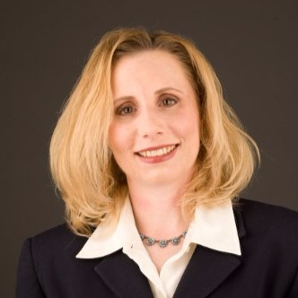
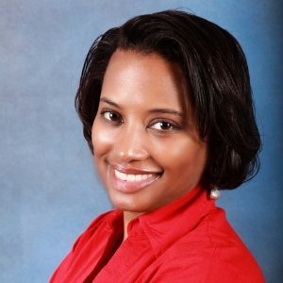
Other Profile-Photo Examples:

Slide 13
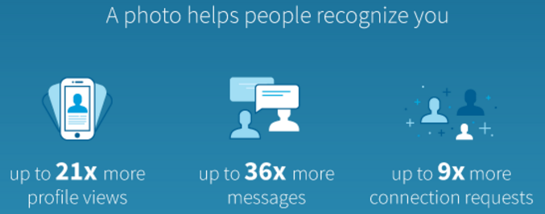
Update Your Mobile App
Photo editing added to the mobile app. Six photo filters are available. You can also crop and edit the brightness, contrast, saturation and vignette of your LinkedIn profile photo.
Source: https://blog.linkedin.com/2017/march/14/linkedin-profile-photo-tips-introducing-photo-filters-and-editing

Slide 14
LI Background Images
New dimensions: 1584 x 396 pixels (4:1 ratio); 4 MB max
Brand yourself with a customized background in Canva
http://www.avidcareerist.com/2015/09/13/linkedin-background-image-canva/ (hat tip to Donna Svei)
https://linkedinbackground.com/
https://www.canva.com/create/banners/linkedin/
http://linkedinformed.com/linkedin-profile-backgrounds/
https://www.linkedin.com/pulse/keep-mind-linkedin-background-image-details-beth-granger
https://www.linkedin-makeover.com/tools/background/
https://wallpapersafari.com/
https://stocksnap.io/

Slide 15
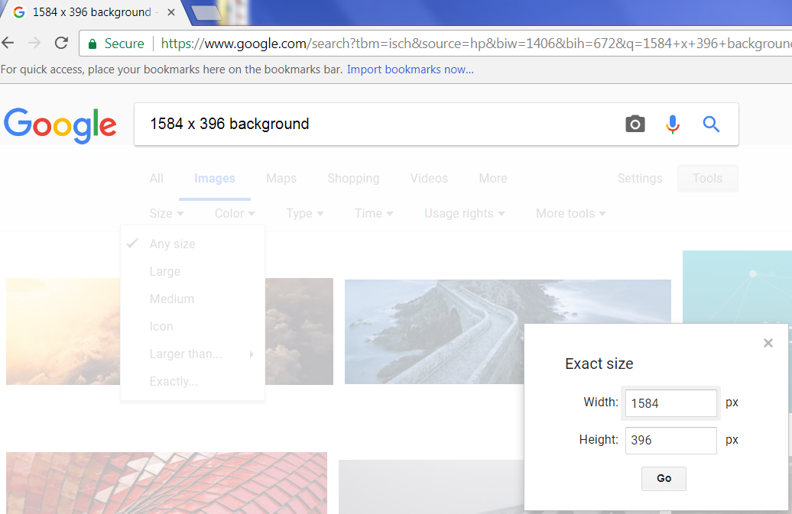

Slide 16
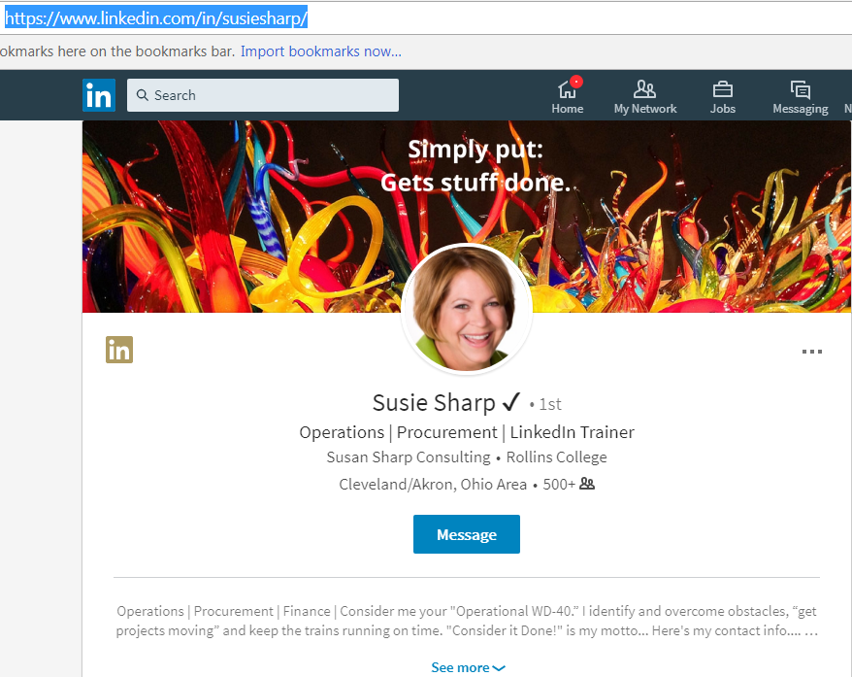
GOTTA LOVE IT!→

Slide 17
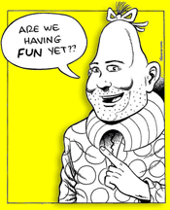
This Should Hold You for a While …
Free Images:
Barn Images: http://barnimages.com
Raumrot: http://raumrot.com
Pixabay: http://pixabay.com
Unsplash: http://unsplash.com
FreeImages: www.freeimages.com
Photocrops: www.photocrops.com
UHD Wallpapers: www.uhdwallpapers.org
Paid Images:
GraphicRiver: http://graphicriver.net
iStock: www.istockphoto.com
ShutterStock: www.shutterstock.com
Imaging Software:
Adobe Spark: https://spark.adobe.com
Canva: www.canva.com
PicMonkey: www.picmonkey.com
Source: Donna Serdula; http://www.linkedin-makeover.com/

Slide 18
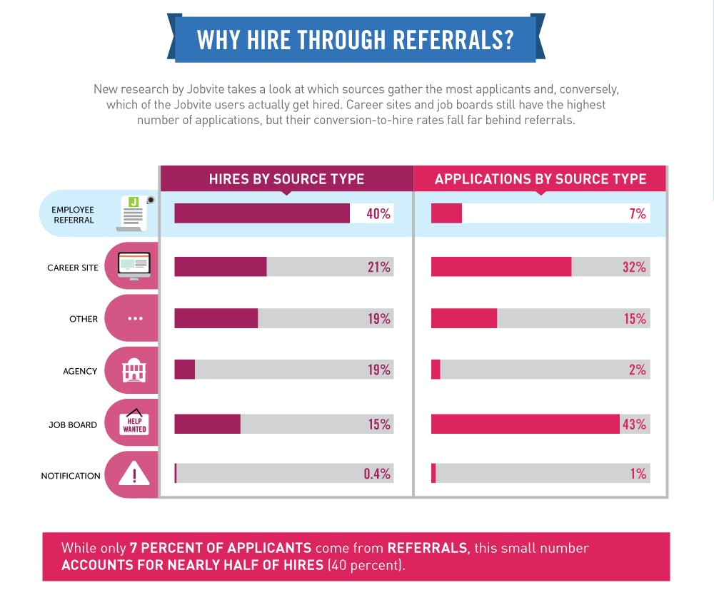
REFERRALS

Slide 20
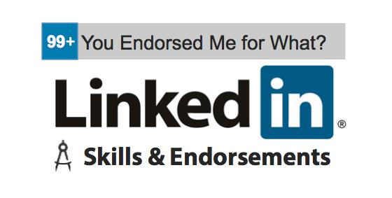
“BEAUTY CONTEST”

Slide 21
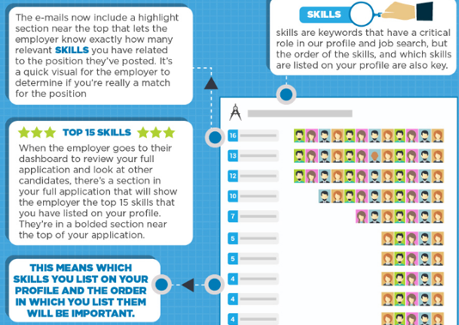
LinkedIn 101
Internal Communications 187
Communication 27
-------------------------------------------
Corporate Communications 224
Strategic Communications 198
Social Media Marketing 132
Public Relations 98
Digital Marketing 91
Social Media 71
Crisis Communications 57
Leadership 51
Newsletters 48
Content Writing 35
Copywriting 31
Strategic Comms. Counsel 23
https://www.linkedin.com/pulse/infographic-linkedin-skill-endorsements-critical-job-jessica-h-

Slide 22
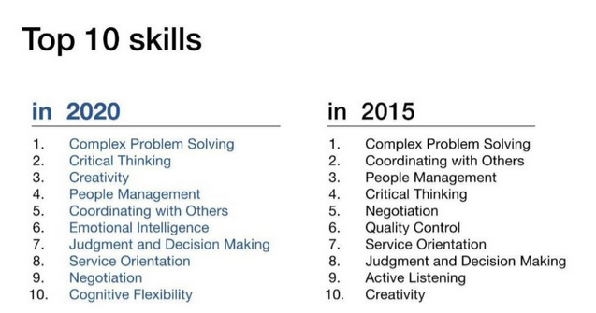
5 MM jobs lost to automation by ’20
Technology & computational thinking
Caregiving
Social intel. & new-media literacy
Lifelong learning (>micro-boredom)
Adaptability & business acumen
Genetic Counselor…Data Detective…Bring Your Own IT Facilitator…Ethical Sourcing Manager…AI Business Development Manager…Master of Edge Computing…Walker/Talker…Fitness Commitment Counselor
AI-Assisted Healthcare Technician…Cyber City Analyst…Genomic Portfolio Director…Man-Machine Teaming Manager…Financial Wellness Coach…Digital Tailor…Chief Trust Officer…Quantum Machine Learning Analyst
Next 10 yrs.: Virtual Store Sherpa, Personal Data Broker, Personal Memory Curator, Augmented Reality Journey Builder, Highway Controller, Genetic Diversity Officer
https://www.techrepublic.com/article/21-weird-tech-job-titles-of-the-future/

Slide 23
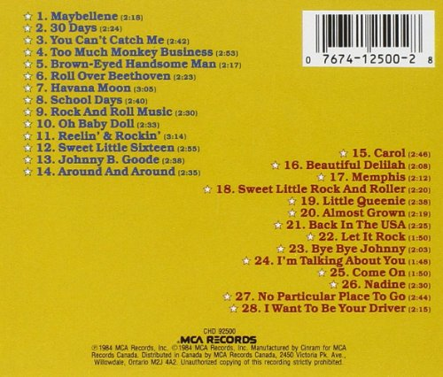
THE GREAT 28

Slide 24
No custom URL
Duplicate profiles
Default background image
No activity
Amateur portrait
Default (unbranded) headline
Default (unbranded) “intro”
Few or no visuals / media
Summary not “chunked” / scannable
Little or no contact info. on first screen
Skills / endorsement #’s low
Recommendations old, few, unbalanced
Summary lacking recent details (#’s)
Notes:
No custom URL (https://www.linkedin.com/help/linkedin/answer/87)
Duplicate profiles (https://www.linkedin.com/help/linkedin/answer/1275)
No background photo (https://www.linkedin.com/help/linkedin/answer/49960)
No activity (articles, posts, likes, comments, shares) (https://www.linkedin.com/in/andyohearn/recent-activity/)
Unprofessional portrait (bad lighting, background, framing, wardrobe, etc.) (https://www.photofeeler.com/)
Insufficiently branding headline (too short, job title only, desperate/cutesy-sounding, few KWs, not action/other-oriented, etc.) (http://www.linkedin-makeover.com/2010/11/05/linkedin-headline-generator/)
Insufficiently branding “intro” (1st 2 summary lines; 200-232 char.; 88-92 on mobile)
Insufficient visuals/media (at least 3; add or link to external documents, photos/scans, sites, videos, and presentations, e.g., SlideShare)
Summary verbiage not “chunked” for scannability
Insufficient or no contact information in/near top of profile
Skills/Endorsements disproportionate to expertise (ideal = 3+ @ 99+)
Recommendations old (>5 yrs.), few, disproportionate (given vs. rec’d.)
Summary verbiage too short (<2,000 char.), too few/old KWs, CARs/PARs, 3rd person, etc.

Slide 25
B.S. & buzzwords (unprovable, self-delusional conversation killers)
Experiences lacking and/or task-oriented rather than achievement-oriented
“Hiccups” and non/counter-progressions (unexplained gaps, timing, transitions, hops, 180° turns)
“Distractions” (duplications, typos, over-sharing, irrelevancy)
“Buried ledes” (e.g., great “testimonial” reco. language not on 1st screen)
Keyword dilution / relegation (e.g., certifications, key projects not on 1st screen)
“Dead letters office” (e.g., too few / too old posts and follow-ups to likes, comments, shares)
“Walls of text” (e.g., undifferentiated by ALLCAPS SUBHEADS, line breaks, wingdings/webdings, etc.)
“Mystery achievements” (e.g., unexplained education/courses, awards/honors, pubs, patents)
Industry / location / etc., too broad (disregarded because too hard to categorize)
Ungrouped series of short-term positions (common thread, vs. “hobo” vagabond / transient)
“Mystery links” (e.g., descriptive language (context) missing or not “curated”
“Bullet bulletins” (conversation-killers; too many, too old, or too few; prioritize and synthesize)
“Dusty old trophies” (e.g., droning on re: experience >15 years (explain education / experience gap)
Relationship avoidance: “FACE TO FACE” (F2F) is Your Ultimate & Ongoing Goal (“Conversion”)
Notes:
LI BS Bingo buzzwords/“zombie-tastic resume phrases” (adjectives; non-conversational/“human”)
Insufficient (“job-description” language; no CARs/PARs #’s) or no experience descriptions
Unexplained career gaps/chronology, transitions, job-hops, sidelines, 180° turns, etc.
Duplications, typos, and other unnecessary “distractions” (e.g., over-sharing, irrelevancy)
Great “testimonial” recommendation language buried too deep within profile (i.e., move up best snippets into Summary section)
Certifications (scans), key projects also buried too deep within profile
Insufficient or dated long-form posts and/or post follow-up to likes, comments, shares, etc.
Insufficient use of visual text (e.g., ALLCAPS SUBHEADS, line breaks, wingdings/webdings, etc.)
Unexplained education/courses, awards/honors, publications, patents, etc.
Industry/location (e.g., more local than “Greater NYC”) not sufficiently narrow/niche
Series of short-term positions not grouped under “umbrella” heading (shared context)
Descriptive language (context) preceding use of links insufficient or not provided
Too many (or too few) bullets for positions of past 5-15 yrs. (prioritize & synthesize)
Failure to “summarize” experience dating back >15 years (gap between education & experience)
FAILURE TO “FACE TO FACE” (F2F) – Virtuous Circle versus Vicious Cycle

Slide 26
10 BEES

Slide 27
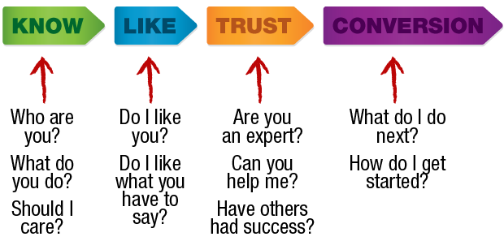
Why Your LinkedIn “Presence” Sting-x
Be Found
Be Known
Be Liked (personality)
Be Trusted (credibility, brand consistency)
Be Recommended/Referred
Be Accessible (multiple contact points)
Be Active (participant, as opposed to passive observer)
Be Giving/Gracious (win-win)
Be Succinct (“be brief, be brilliant, be gone”)
Be You (real, genuine/authentic, interesting/engaging)
Sources: http://internet-marketing-success-pro.com/build-maintain-and-protect-your-authority-visibility-credentials-and-credibility-on-the-web-in-online-marketing/; http://cdn.playbuzz.com/cdn/fa468afa-cb34-4116-8ce0-d7e9c2f72ca0/db375465-e6f0-4123-b59b-65bbd68378b6.jpg

Slide 28
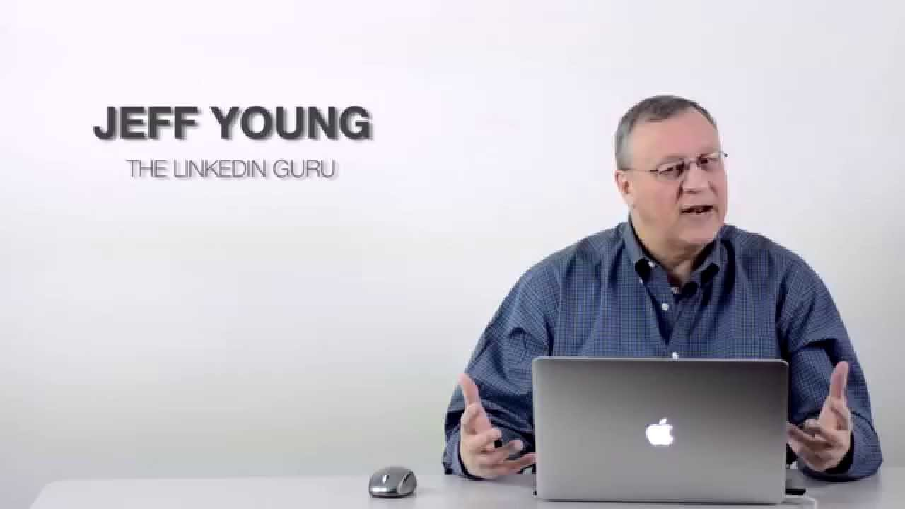
LI GURU TOUR

Slide 29
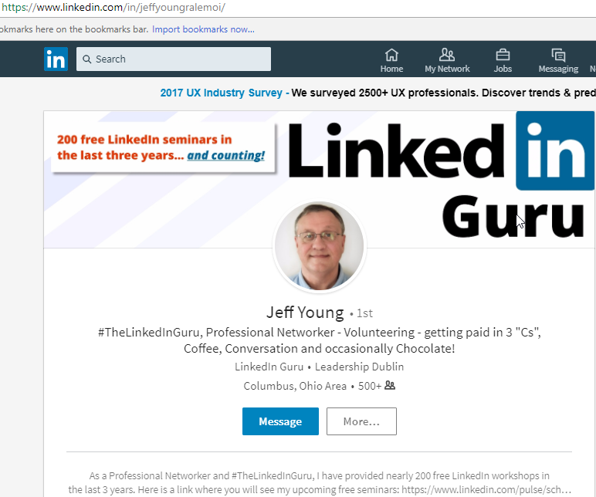

Slide 30
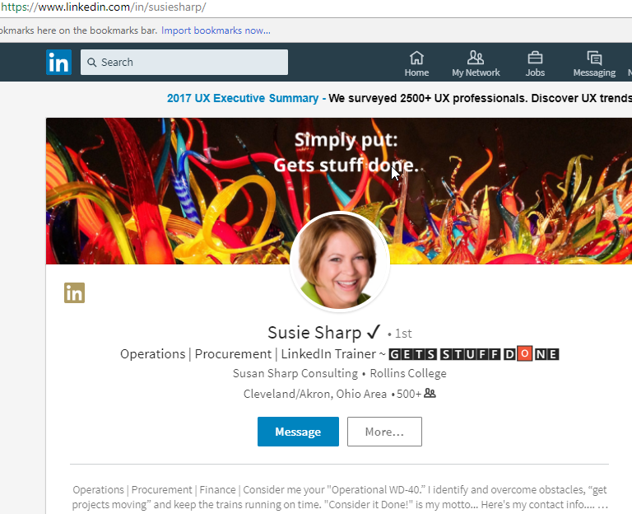

Slide 31
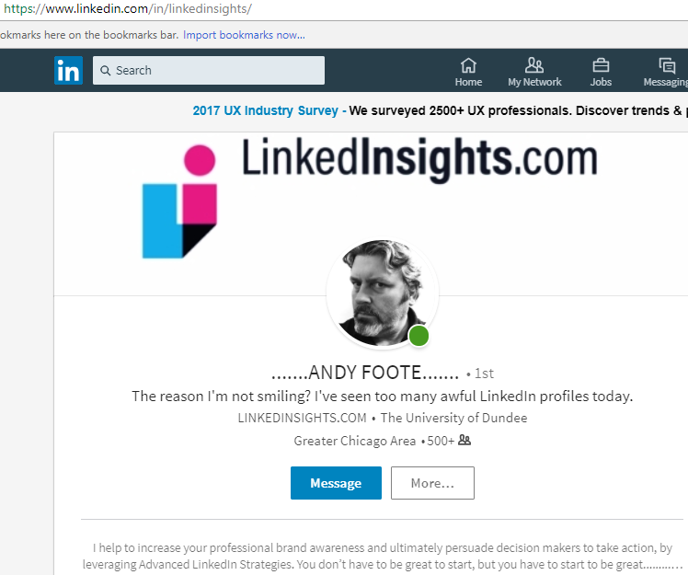

Slide 32
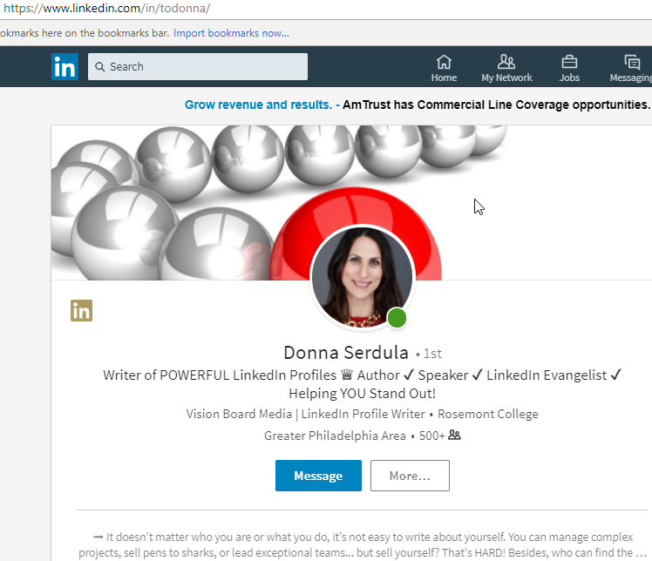

Slide 33
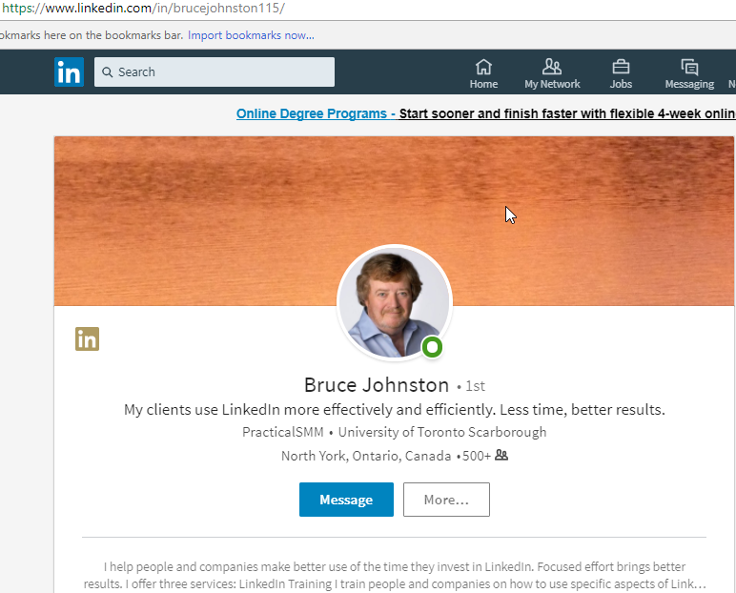

Slide 34
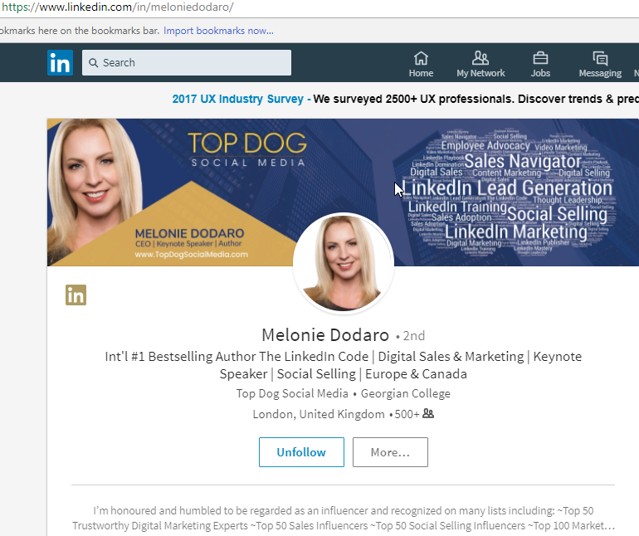

Slide 35
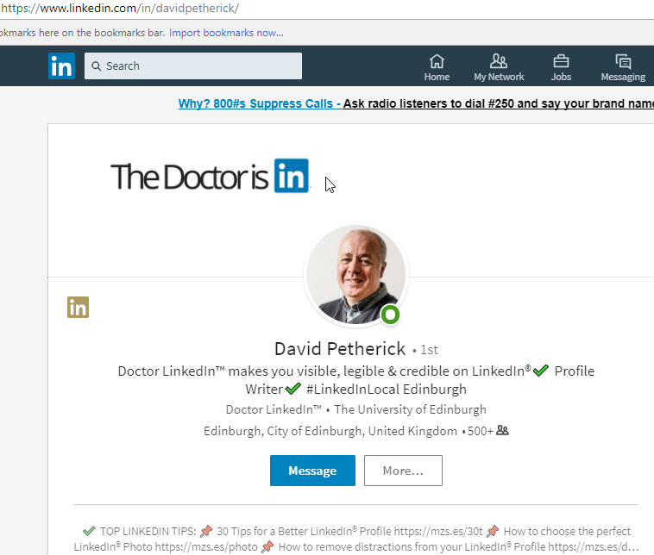

Slide 36
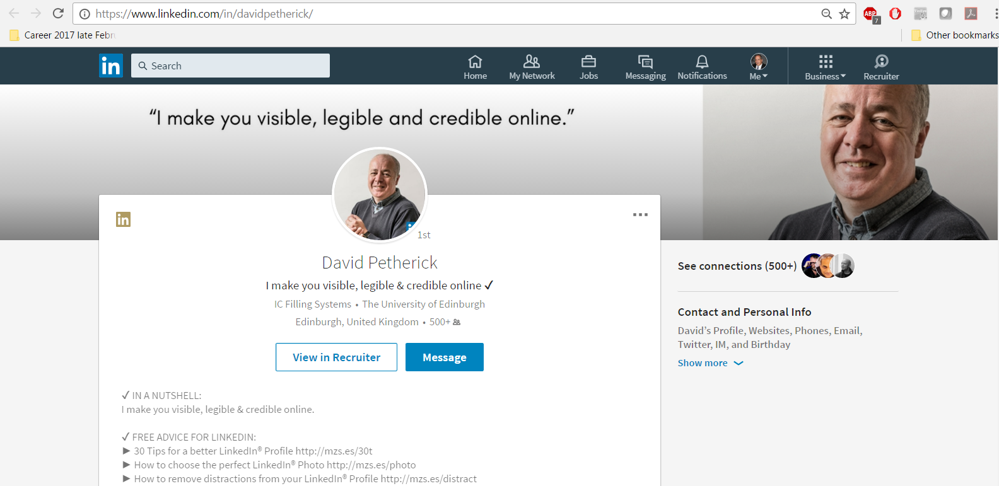

Slide 37
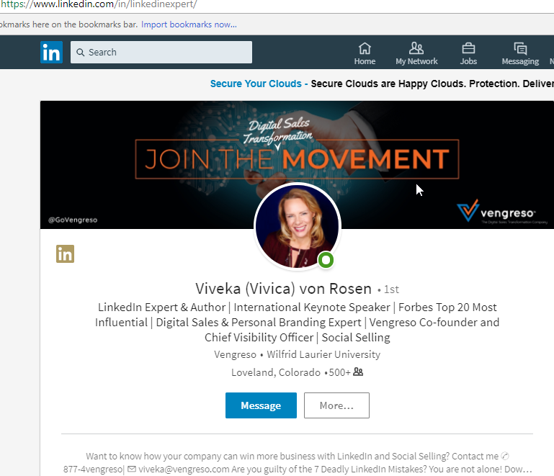

Slide 38
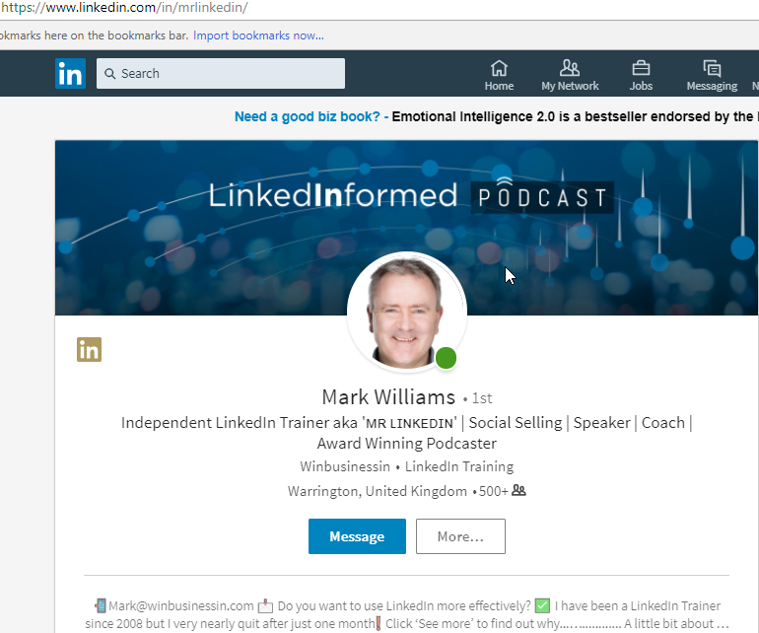

Slide 39
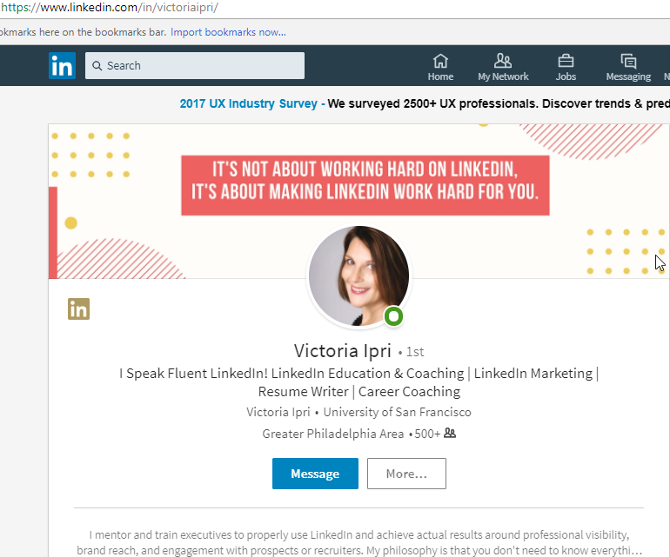

Slide 40
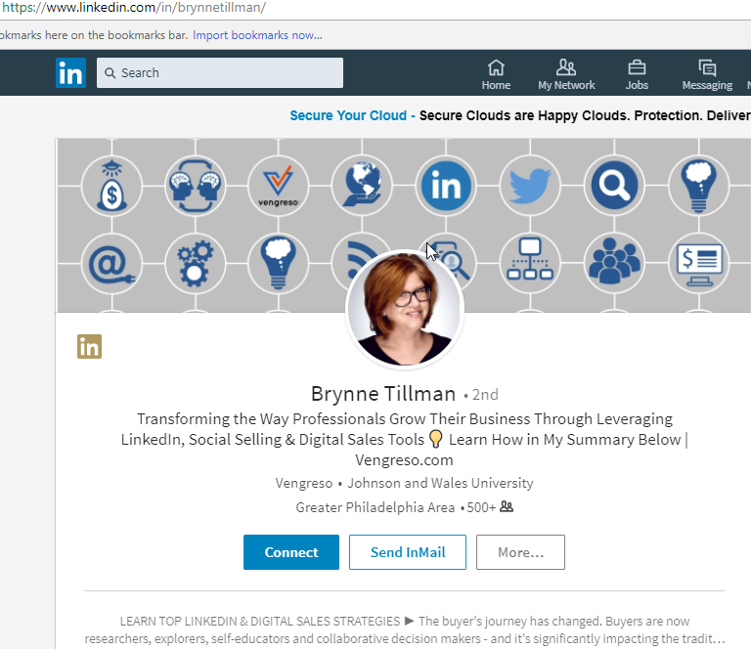

Slide 41
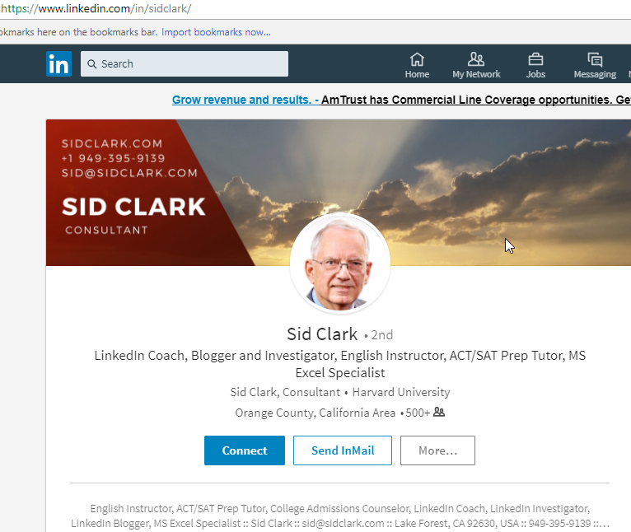

Slide 42
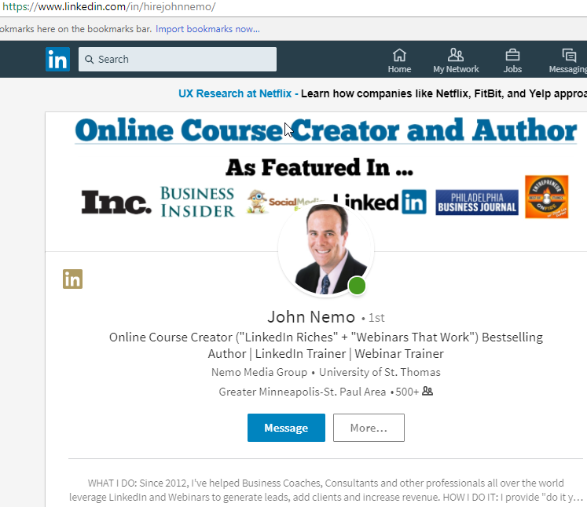

Slide 43
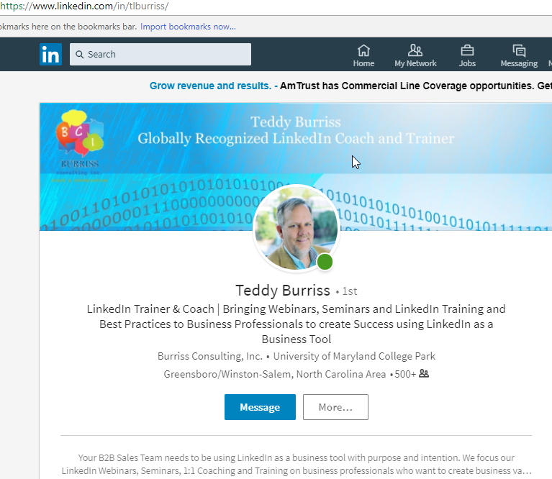

Slide 44
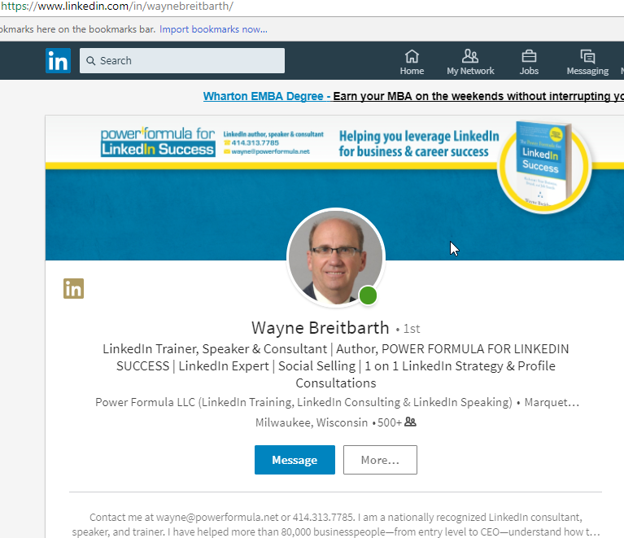

Slide 45
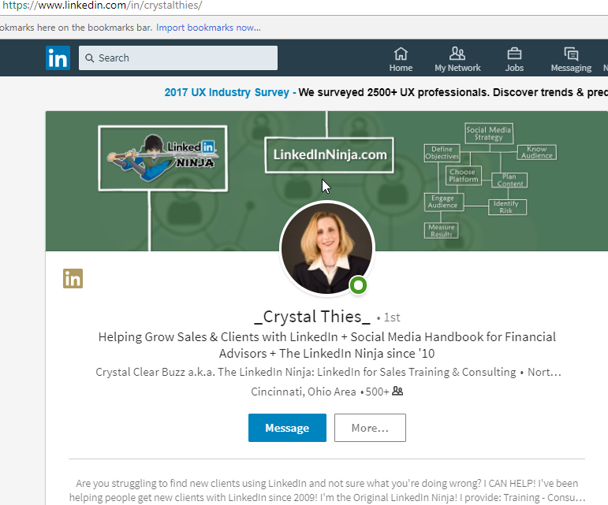

Slide 46
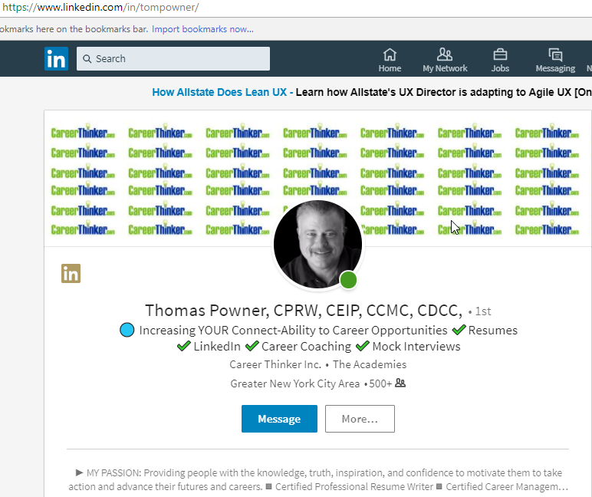

Slide 47
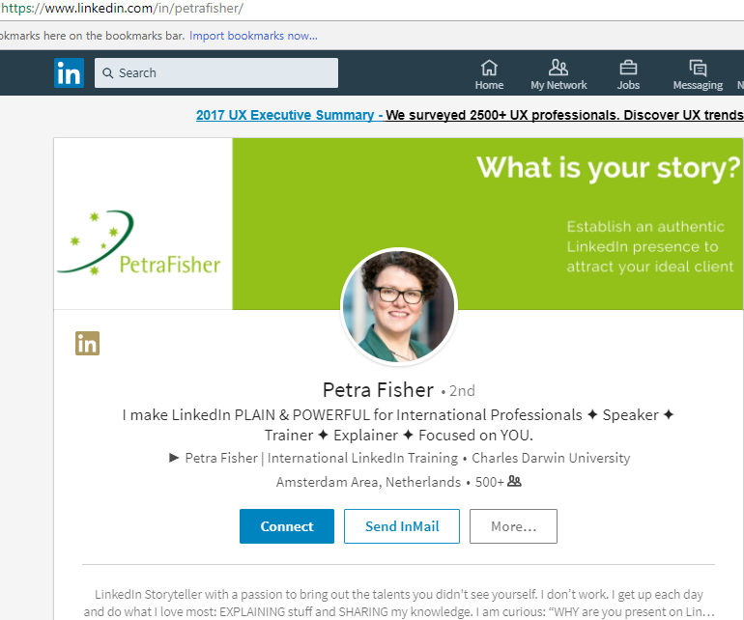

Slide 48
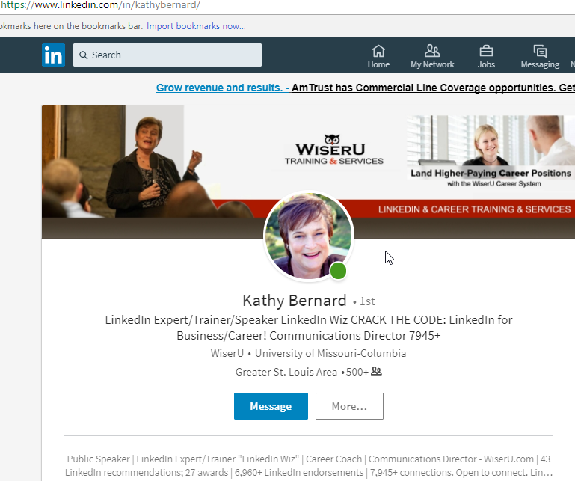

Slide 49
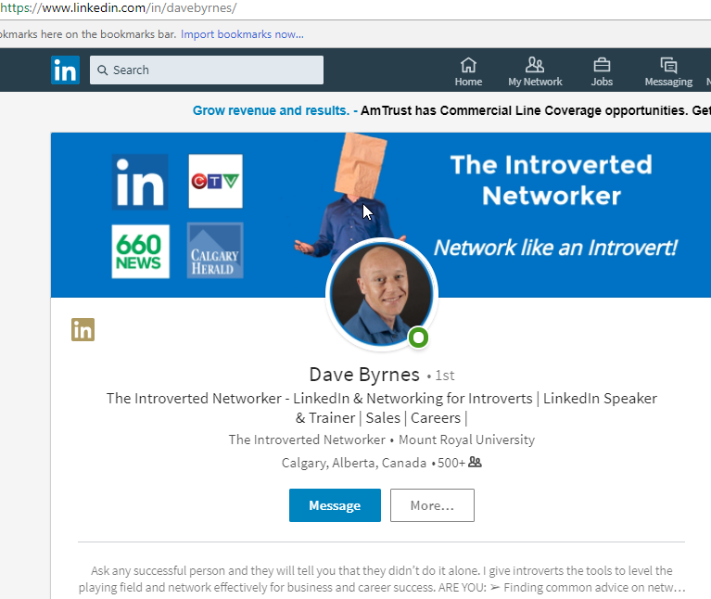

Slide 50
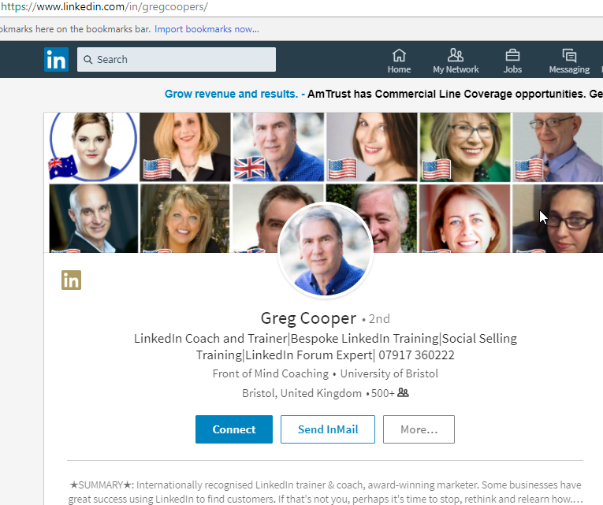

Slide 51
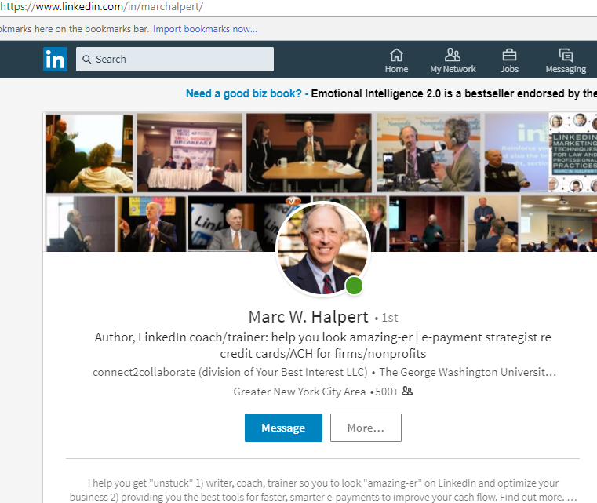

Slide 64
HEADLINE =
LIFELINE

Slide 65
Source: Noelle Gross, www.ngcareerstrategy.com; http://www.laurenbergerinc.com/how-to-write-a-compelling-linkedin-headline/

Slide 67
Your Headline is KEY
Source: Thomas Powner; careerthinker.com/
Increasing YOUR Connect Ability to Career & Business Opportunities ✓Resumes ✓LinkedIn ✓Career Coaching ✓Mock Interviews (117; https://www.linkedin.com/in/tompowner/)
Director of Sales – Leading Teams to Drive Sales, Profits & Build Excellence in Operations, Service & Loyal Partnerships (120)
Creative DirectorUX UI DesignerWeb & Graphic DesignerIgniting Consumer Engagement to Drive Brand Identity & Sales (118)
VP | General Manager Specializing in Luxury Brands in ✔Beauty ✔Health ✔Fashion Sales, Operations & Financial Leadership (120; https://www.linkedin.com/in/fviargues/)
SOFTWARE ENGINEER | APPLICATION ARCHITECT | Design ✔Test ✔Deliver High-performance Tech Solutions Improving Processes & Systems (120)
http://www.linkedin-makeover.com/linkedin-headline-generator/
Source: Donna Serdula

Slide 68
More Headline Examples
Source: Donna Serdula
Insurance Broker & Agent  Giving You Peace of Mind by Protecting Your Home, Car, and Assets
Financial Advisor  Taking Away the Guesswork from Investments  Helping You Plan and Achieve Your Future Goals
Real Estate Agent  Helping Families in New York City Find the Home of their Dreams!
Sales Consultant  Helping Businesses Develop Strong Sales Forces through Intensive Sales Training Programs

Slide 69
And Yet More Headline Examples …
Source: Donna Serdula
Software Engineer Building the Applications that Make Your Business Life Easier
Project Manager with a Passion for Coding and Technical Writing, Looking to Positively Impact a New Organization
IT Specialist Devoted to Creating Stable, Scalable Solutions for Small Businesses
Business Analyst Helping Companies Translate Their Business Goals and Ideas to Operational Reality and Positive ROI
Interim CEO Solving urgent leadership problems … when your CEO steps down, I step up!

Slide 70
BITE-SIZE (CHUNX)

Slide 71
This is a “chunked” Summary … note how much easier it is to SCAN … because no one actually READS your LI Profiles!
Source: John Nemo; http://linkedinriches.com/

Slide 72
Source: Thomas Powner; careerthinker.com/ and https://www.linkedin.com/in/fviargues/

Slide 74
Be Known & Liked: Summary; Visibility (e.g., Posting)
Source: John Nemo; http://linkedinriches.com/

Slide 75
Be Known & Liked: Summary; Visibility (e.g., Posting)
WHAT I DO: I help [MY TARGET AUDIENCE] achieve [THEIR TOP GOAL] by providing [MY PRODUCT or SERVICE].
WHO I WORK WITH: I partner with [TARGET AUDIENCE or INDUSTRY TYPE] including:
[INSERT BULLETED LIST OF JOB TITLES, INDUSTRY NAMES, etc.]
WHY IT WORKS: When you partner with [MY COMPANY NAME] you get the most efficient, effective and affordable [PRODUCT or SERVICE] that [TARGET AUDIENCE] is looking for right now.
WHAT MAKES [ME or US] DIFFERENT: [Answer that question! What makes you unique/different/better than similar vendors or competitors? XYZ years of experience? Certifications/Patents/etc.? Personal, 1-on-1 attention and Customer Service/Support?]
WHAT OTHERS SAY: [COPY AND PASTE IN 2-3 TESTIMONIALS IN THIS AREA. USE A REAL PERSON, FULL NAME, COMPANY NAME, ETC. AND EXPLAIN SPECIFIC VALUE/BENEFIT PERSON RECEIVED FROM YOU OR YOUR BUSINESS.]
HOW IT WORKS: [Explain Your process – we start with a free evaluation, we first meet via phone to discuss your needs, etc., or we perform XYZ services for you, etc.]
READY TO TALK? Reach out to me directly here on LinkedIn, email me at [EMAIL ADDRESS], visit us online at [WEBSITE URL] or call me direct at [PHONE NUMBER].
Source: John Nemo; http://linkedinriches.com/linkedin-summary-tips/

Slide 76
“POST-ALL” SERVICE

Slide 77
Be Known & Liked: Visibility (e.g., Posting)
Source: https://www.linkedinsights.com/maximum-linkedin-character-counts-limits-for-2018/

Slide 78
http://ow.ly/i/xUFPd/original

Slide 80
Be Known & Liked: Summary; Visibility (e.g., Posting)

Slide 81
VERB/#’s> NOUN> ADJECTIVE
(BAN LI B.S. BINGO)
Source: http://www.bullshitbingo.net/cards/bullshit/

Slide 82
Source: https://blog.linkedin.com/2017/january/25/better-than-buzzwords-2017-is-the-year-to-start-showing-it-linkedin

Slide 86
Do these SOUND like “weekend words” to you? Or merely “weakened” words?
Could an average sixth-grader even begin to understand what you are talking about?
Is your Flesch Readability score (MS Word) in the stratosphere?
(http://www.readabilityformulas.com/free-readability-formula-tests.php)
Results-oriented Processional with a bottom-line orientation
Motivated self-starter
Superior communication skills
Savvy/seasoned/strategic Business Professional
Meets or exceeds expectations
Strategic visionary
Proven track record of success
Skilled at leading cross-functional/high-performing teams
Progressively more responsible positions
Dynamic industry leader
Source: Liz Ryan; http://www.humanworkplace.com/
→ 2:30 pm

Slide 88
IKIGAI

Slide 90
https://www.linkedin.com/pulse/career-circles-ikigai-jared-j-wiese

Slide 91
aka HEALTH:
cardio/intensity
cycling
diagnostics
diet/nutrition
discipline
doing/movement
energy/hydration
fitness/endurance
flexibility/yoga
grit/goals
aka CREATIVITY/MOTIVATION/DRIVE:
analytics/statistics
adventure
communications
curation
economics
editing
Epicureanism
expression
fun
history/biography
humor
knowledge mgmt.
learning
music (blues/harp)
habits
healthcare
hiking/exploration
hygiene
pain mgmt.
running/sports
stress mgmt.
walking
weight mgmt.
wellness
news/media
photography
presentation
reading
recognition
reference
research
romance/eros
social sciences
storytelling
technology/gadgets
travel
words/language
writing
PRIME (PHYSICAL)
PASSIONS
aka RELATIONSHIPS:
affinity/connection
barter/trade/share
collegialism
commentary
community
consumerism
credibility
culture
dialectic/philosophy
emotional IQ
empathy
family/pets
friendship
influence
law (torts)
marketing
networks
persuasion
power dynamics
psychology
social media
trust
volunteerism
vulnerability
aka LEGACY:
accountability
advisor
advocacy
altruism
ambivert
authenticity
calling/vocation
change mgmt.
coach/mentor
compassionate
concierge
consultant
counselor
donation (blood)
fairness/justice
guidance
iconoclastic
inspirational
kindness
leadership (servant)
leadership (thought)
listening
loyalty/principles
regret-free
reliability
responsibility
strategic
values
PEOPLE
PURPOSE
aka $ECURITY/CURRENCY:
“brand” (self-sales)
budget/finances
career/progress
commute/trans.
de-clutter/organize
investments
insurance
job/gig search
Life-hacks
maintenance
planning
possessions
productivity
quality of life
retirement
service providers
shopping/deals
taxes/credit
time mgmt.
utilities
wardrobe
will/legal/gifts
PEACE OF MIND
PRAJÑĀ aka HIGHER WISDOM:
aesthetics
balance
being
core/oneness
Deism
essentialism
freedom
healing
inner peace
nature
pacing
perspective
poetry
reflection
relaxation
self-actualization
simplicity
soul/spirit
space
variety
Zen/Taoism

Slide 92
https://lifereimagined.aarp.org/activity-app/37341/step/0

Slide 93
F2F / RELATIONSHIPS

Slide 94
This slide provided courtesy of Susie Sharp: Connect with her at https://www.linkedin. com/in/susiesharp/ (do NOT share without her express permission)

Slide 95
How are Trustworthy Others Telling Your Story to Hiring-Process Influencers?
You can’t always reach THE hiring manager (or even be sure who s/he is)
You can usually reach someone within her/his circle of influence/trust
LinkedIn represents how your story gets told when you are not around
LinkedIn is an easy way of “up-selling” you to those that decide your hire
LinkedIn showcases your “2020” skills: complex problem solving, critical thinking, creativity, people management, coordinating w/ others, emotional IQ, judgment & decision-making, service orientation, negotiation, and cognitive flexibility … “will s/he abide by the No A-Hole rule?”

Slide 97
Source: https://bayintegratedmarketing.wordpress.com/2013/05/30/thank-you-linkedin-not/
→ 4:30 pm

